Slide 1

Lion Fixed Income Semester Report
George Tupy
Fall 2025

Slide 2
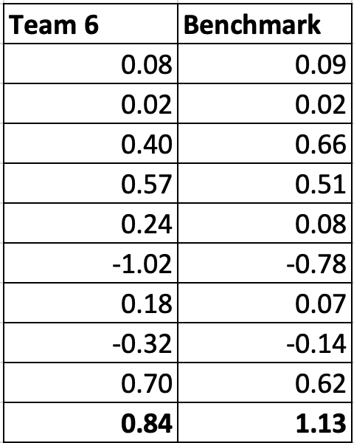
Performance Contributors
High yield credit surged during strong equity and risk-on weeks
MBS holdings provided steady carry and downside protection mid-semester
Long-duration Treasuries gained from Fed rate cuts and curve steepening
Short-term corporates helped stabilize returns during volatile market periods
BBB-rated corporates captured spread tightening without excessive downgrade risk
Executive Summary
Portfolio Performance
George maintained a consistent, aggressive allocation throughout the semester, heavily weighted toward high yield credit and risk-on exposures. While the strategy aimed to outperform the Bloomberg Aggregate Index, cumulative performance fell short, returning 0.84% versus the benchmark’s 1.13%. Despite strong weeks like Week 4 and Week 9, volatility in mid-semester—especially Week 6—highlighted the downside of a static, high-risk posture.
Performance Detractors
Static allocation limited flexibility during mid-semester market volatility spike
High yield exposure underperformed during risk-off weeks like Week 6
No duration hedging left portfolio vulnerable to rate shocks
Lack of short-term Treasuries reduced downside protection and liquidity
Aggressive credit bias missed safer carry from investment grade corporates

Slide 3


Market Review
Treasury & MBS
Market
IG Credit Market
HY Credit Market
Overall Credit Market
Treasuries: Yields declined across the curve as Fed rate cuts took hold; portfolio duration extended to ~8.05 years, consistently long vs. AGG (~6.4)
Curve Dynamics: Short‑end yields fell faster than long‑end, creating a modest steepening.
Strategic Role: Treasuries and MBS acted as ballast against the high yield overweight, reinforcing the barbell structure.
Stable Core: IG corporates held steady at ~20% allocation, anchoring the quality bias in the portfolio.
Credit Quality: BBB corporates (~15%) added incremental yield while staying within IG boundaries.
Market Conditions: IG spreads remained tight, supported by strong corporate earnings and liquidity.
Strategic Role: IG credit provided stability and predictable income, offsetting riskier HY exposure.
Delivered ~7% YTD returns by November, supported by Fed easing and investor demand for carry.
Spreads widened modestly in October (+14 bps) but stayed near long‑term lows.
Defaults ticked up in cyclical sectors (e.g., RE- Workday, auto- First Brands) though systemic risk remained contained.
HY outperformed leveraged loans and preferreds in November, aided by rate cuts.
Liquidity remained strong; spreads near historical tights despite modest default uptick. Consumer credit balances expanded, with revolving debt growth outpacing non‑revolving.
Mortgage and auto delinquencies rose YoY, but unsecured credit performance improved.
Corporate issuance rebounded, with 2025 supply expected to grow ~12%.

Slide 4
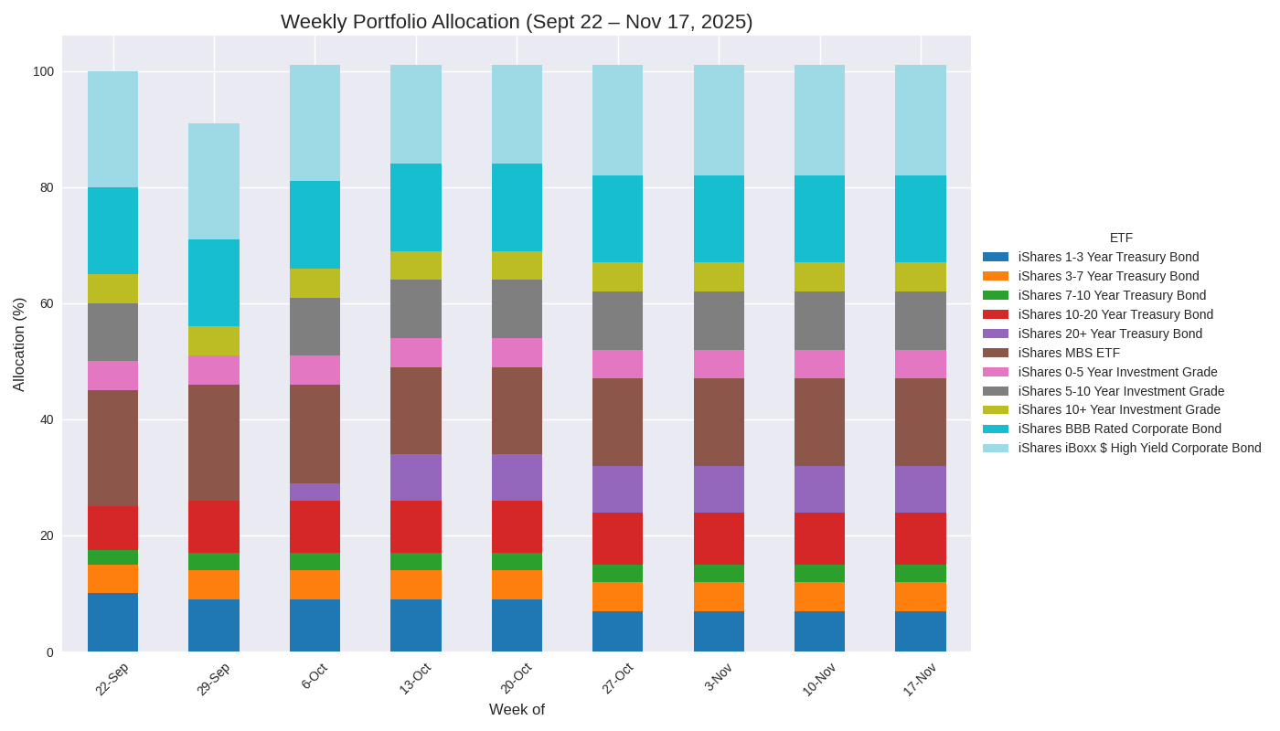
Portfolio Review- Allocation
Weekly Portfolio Allocation
High yield tilt: deliberately leaned into HY corporate throughout period capturing spread compression in Fed easing environment
Credit Barbell: meaningful exposure to Treasuries and IG corporates; risk-on carry from HY, risk-off from Treasuries
MBS Trim: reduced from 20% to 15% to reflect caution around spread tightening
BBB Corporates: 15% steady throughout provided incremental yield while maintaining IG limits

Slide 5
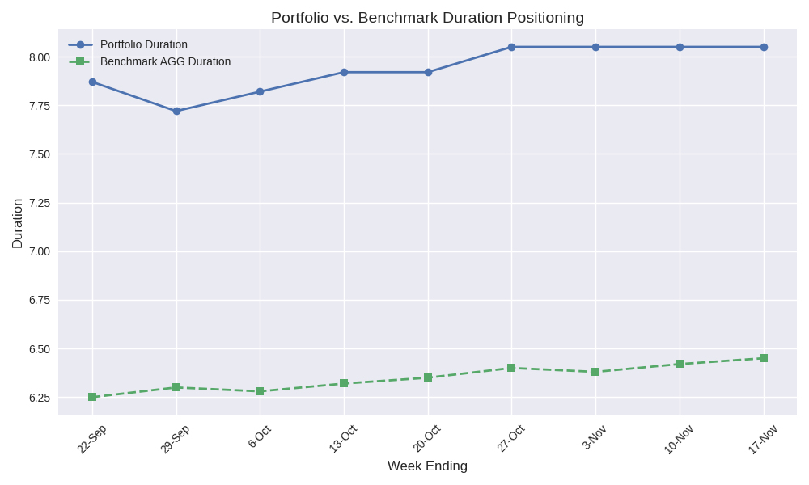
Portfolio Review- Duration
Weekly Portfolio Duration
Extension Strategy: Duration gradually extended from ~7.7 to ~8.05, consistently running long against benchmark (ACG)
Rationale: Designed to benefit from falling yields as Fed pivoted to rate cuts, while maintaining convexity in longer Treasuries
Stability: Conviction in rate outlook rather than tactical trading once stabilized in October

Slide 6
Future Outlook
Economic
Credit
Investment
Growth: U.S. economy resilient but slowing; labor market softening
Inflation: Moderating headline inflation, services inflation looks sticky
Policy: Fed easing cycle underway; chance for rate stagnation at Dec. meeting
Corporate Credit: spreads near tights; liquidity strong, defaults ticking up in cyclical sectors
Consumer: Rising balances; delinquencies creeping up, unsecured credit improving
High Yield: Supported by fed cuts, limited upside given spreads
Quality Bias: Favors IG corporates and agency MBS for stability
Selective HY: Maintain overweight in defensive sectors to capture carry
Duration Tilt: Slightly long vs. benchmark to benefit from falling yields

Slide 7
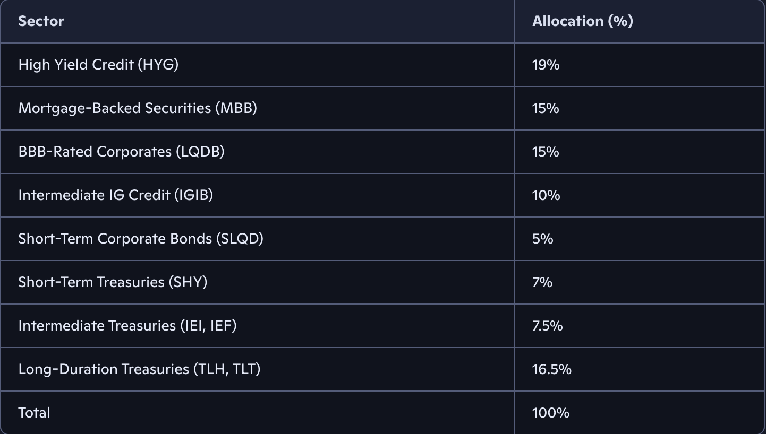
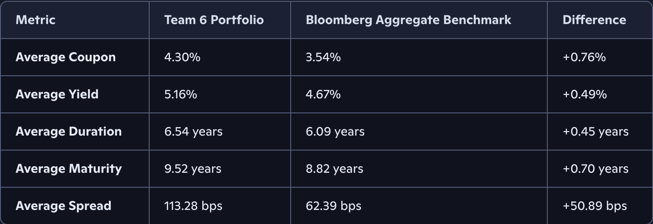
Portfolio Positioning and Characteristics
Sector Allocation (% of Portfolio)
Heavy high yield credit allocation drove income but added volatility.
Strong MBS exposure provided carry and some defensive characteristics.
BBB corporates increased spread risk, consistent with aggressive credit tilt.
Balanced Treasury exposure across short, intermediate, and long maturities supported duration strategy.
Minimal short corporates reduced liquidity buffer compared to benchmark.
Final mix: Concentrated in credit risk, less diversified than Bloomberg Aggregate.
Portfolio Metrics
Higher coupon and yield show portfolio tilted toward riskier, income‑heavy bonds.
Longer duration indicates greater sensitivity to interest rate changes than benchmark.
Extended maturity profile reflects preference for longer‑dated securities, amplifying volatility.

Slide 8
Thank You

