Slide 1


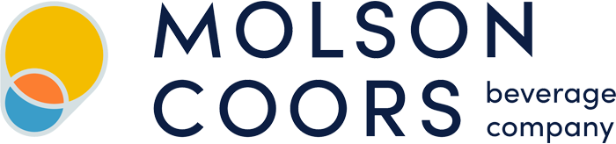
Molson
Coors Company©
By: George Tupy

Slide 2
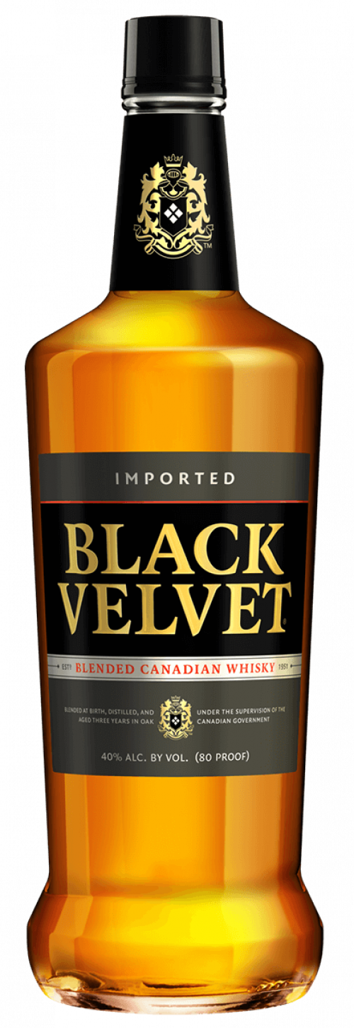
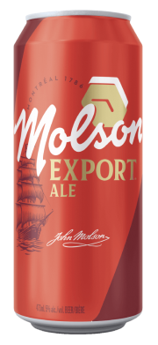
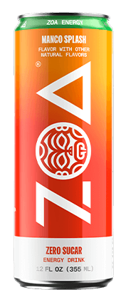
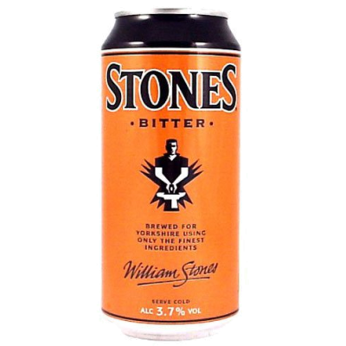
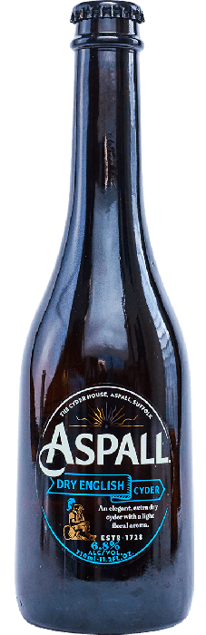
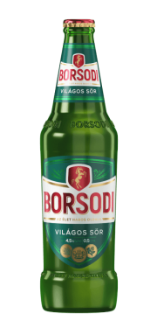
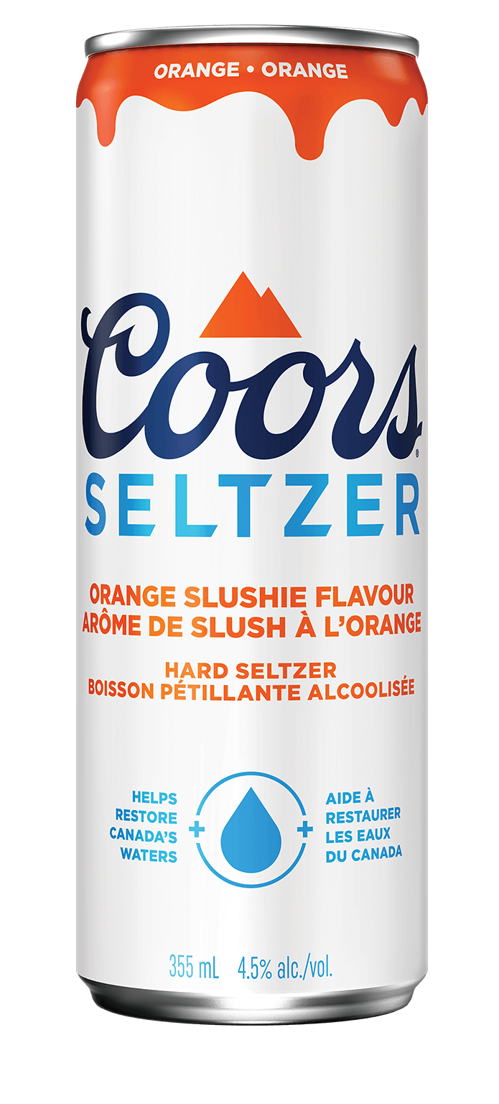
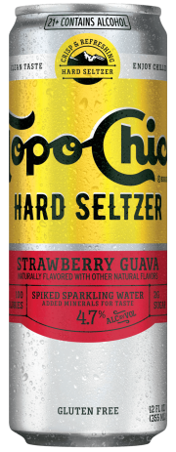
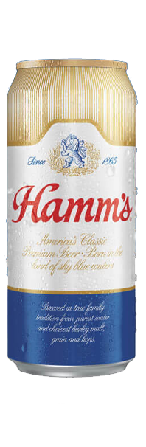
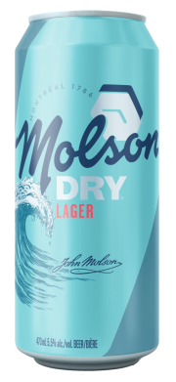
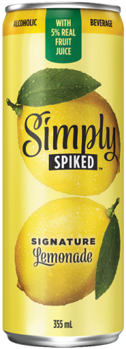
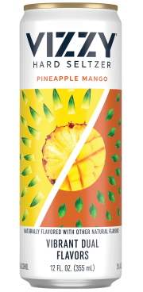
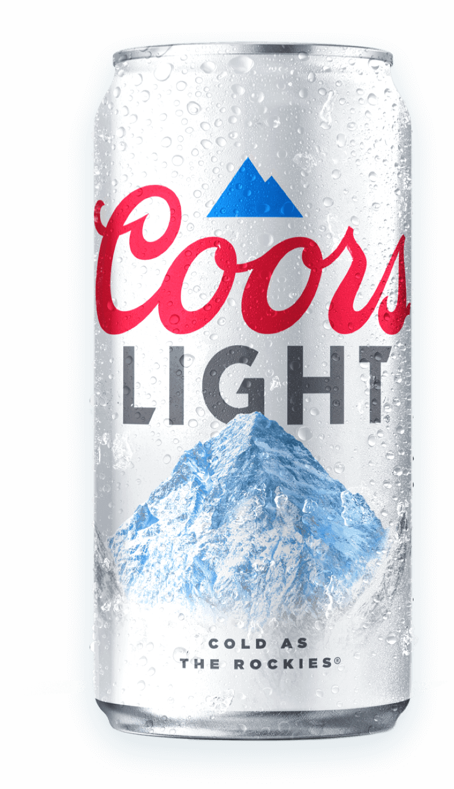
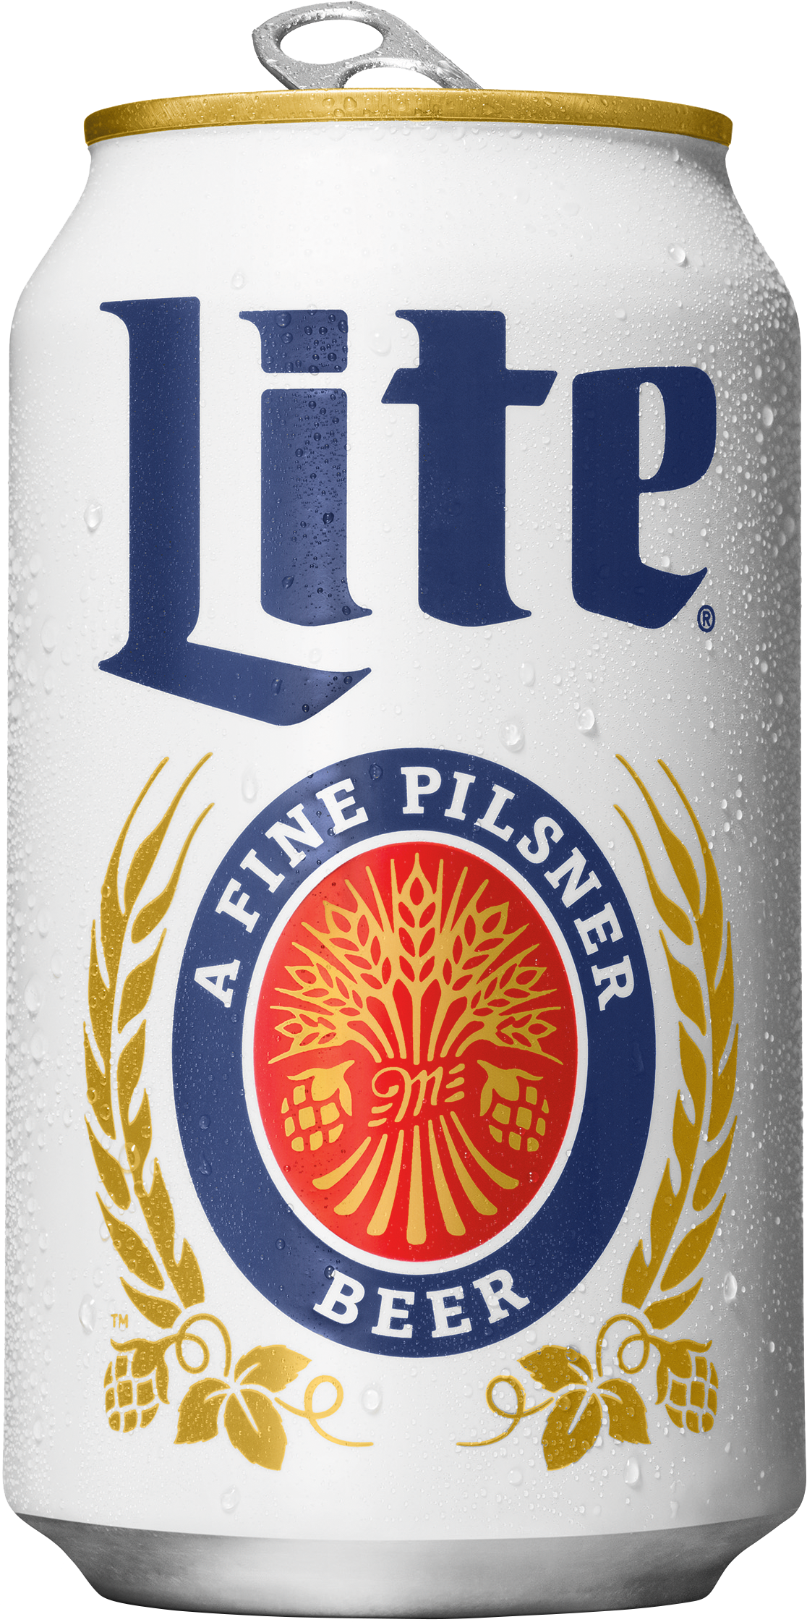
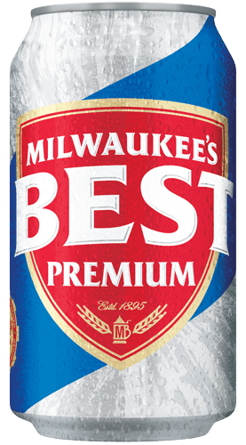
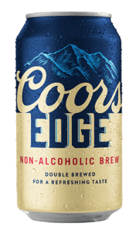
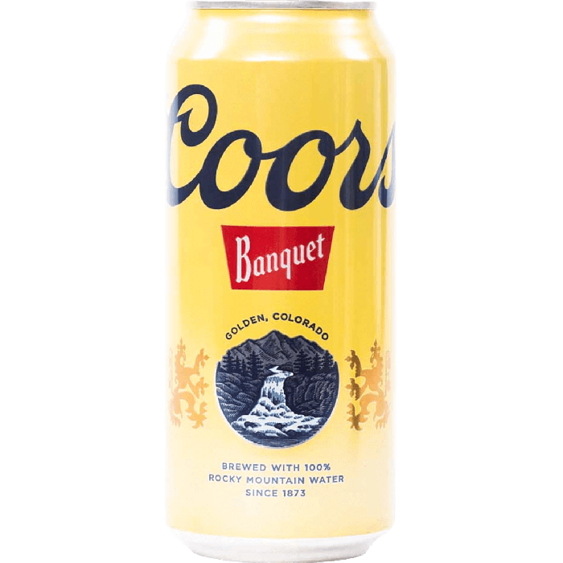
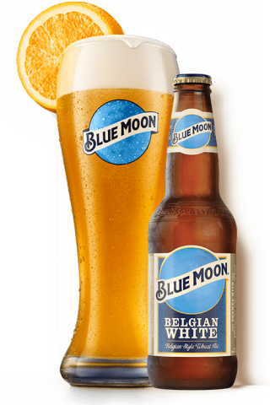
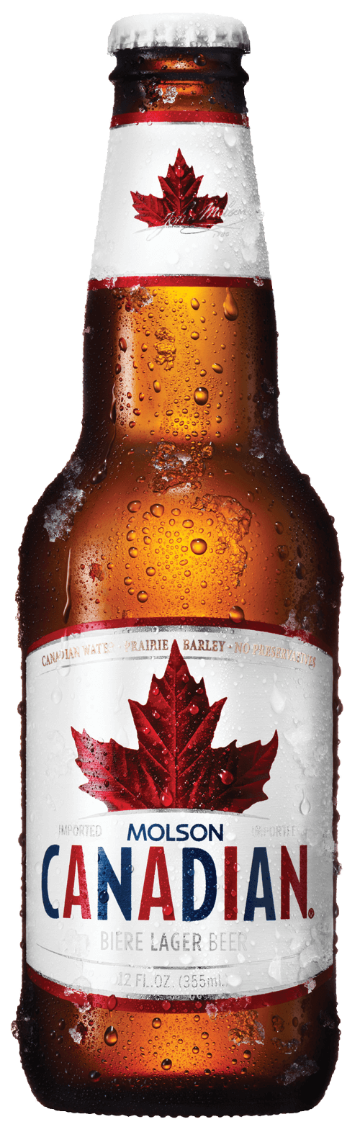
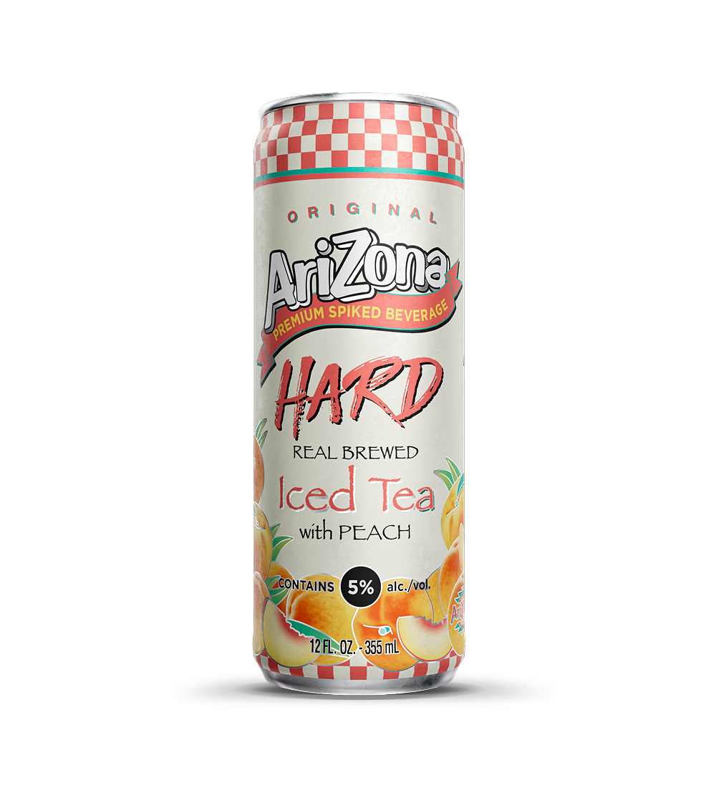
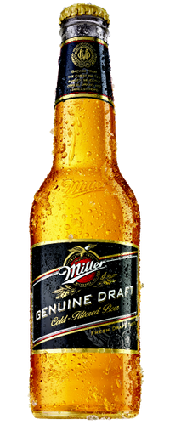
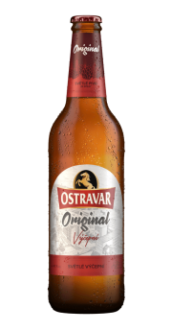
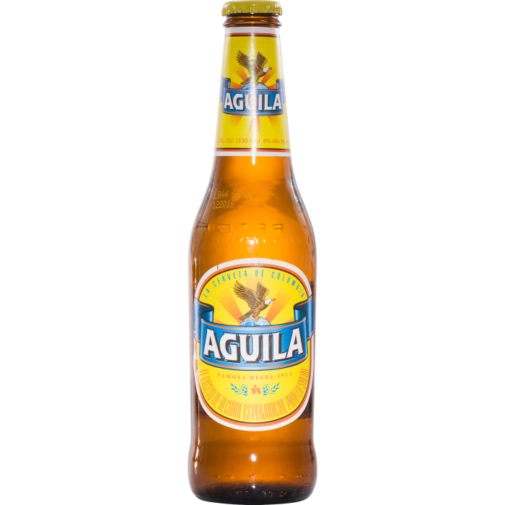
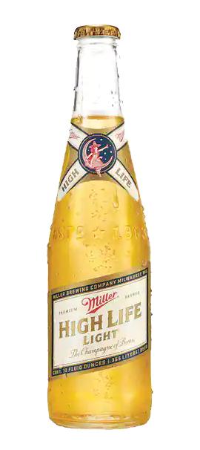
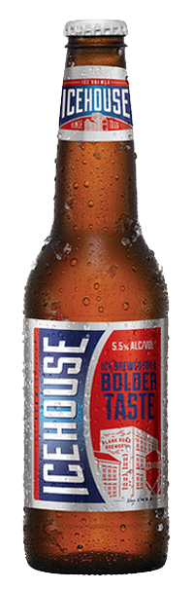
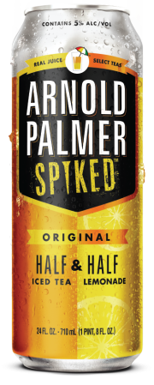
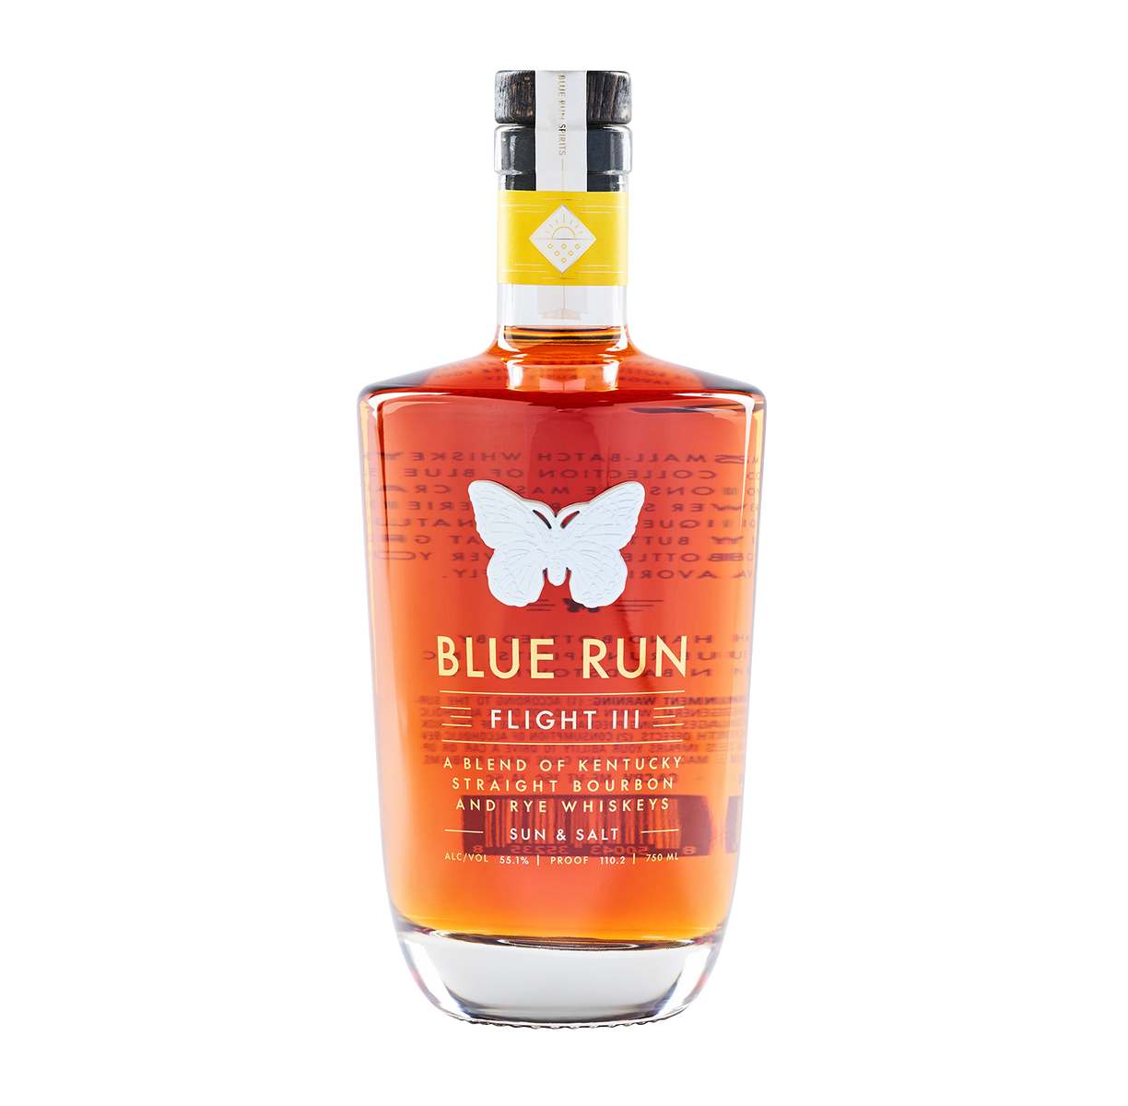
Company Overview
Based out of Chicago and Montreal
Global producer and distributor of beer and beverage brands
Iconic brands including Coors Light, Miller Lite, and Blue Moon
Operates in 80 countries with ~17,000 employees
M&A high growth strategy; “total beverage” portfolio
Notes:
M&A strategy is acquiring emerging seltzer and energy drink companies, diversifies their portfolio and gives them exposure in different markets
2020 they changed from Molson Brewery to Molson Coors Beverage Company

Slide 3
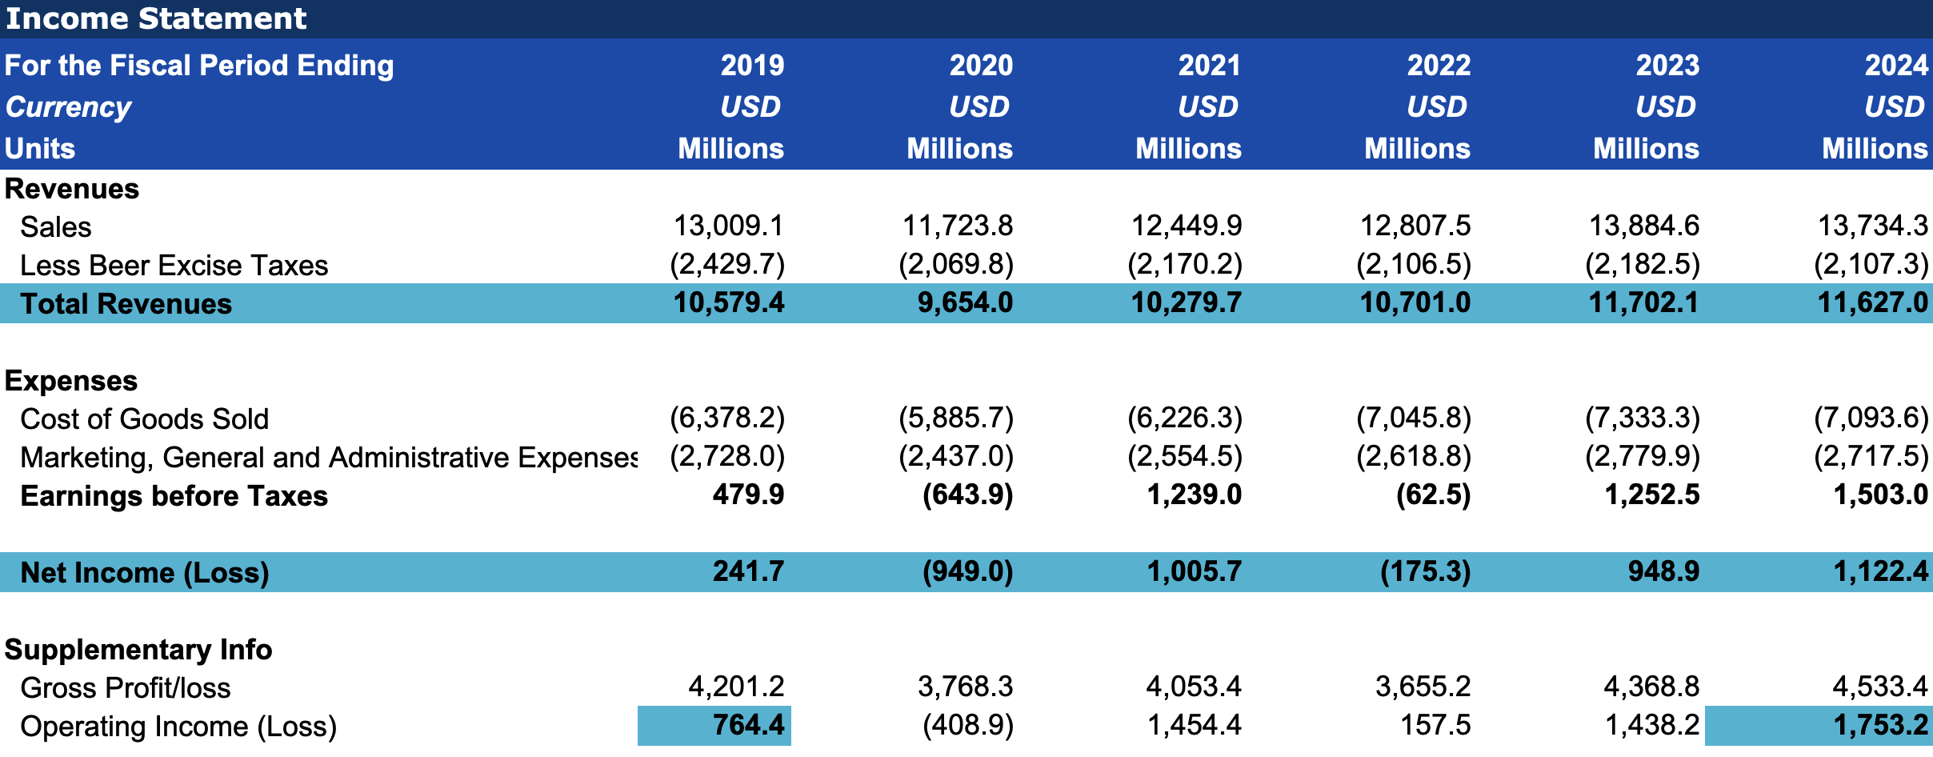
Financial Performance 1
Molson has recovered to pre-pandemic financial performance and is trending upwards
Notes:
- From 2020 Q1 earnings call: “In North America and particularly in the U.S., we benefited from pantry-loading at the end of March that positively impacted our brand volumes, as sales to retailers in the U.S. finished the quarter, reflecting improved trends from earlier in the quarter.”
- COGS fell in 2020 because on-premise (bars, restaurants) closures resulted in less demand in their products
20222 Net Income was reported a loss primarily due to a Goodwill Impairment resulting from a loss from the “Americas reporting unit” meaning their America breweries and assets
Talk about how their operating income has more than doubled since 2019
Talk about how their Net Income was only affected for one fiscal year from the pandemic

Slide 4
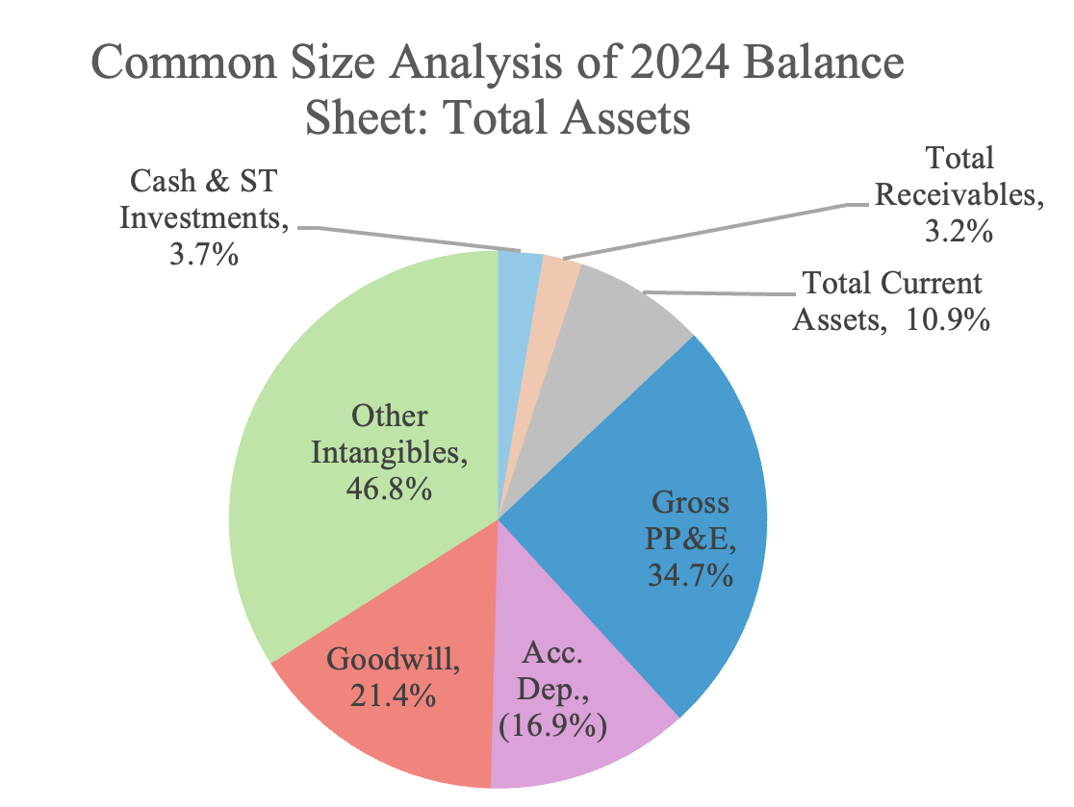
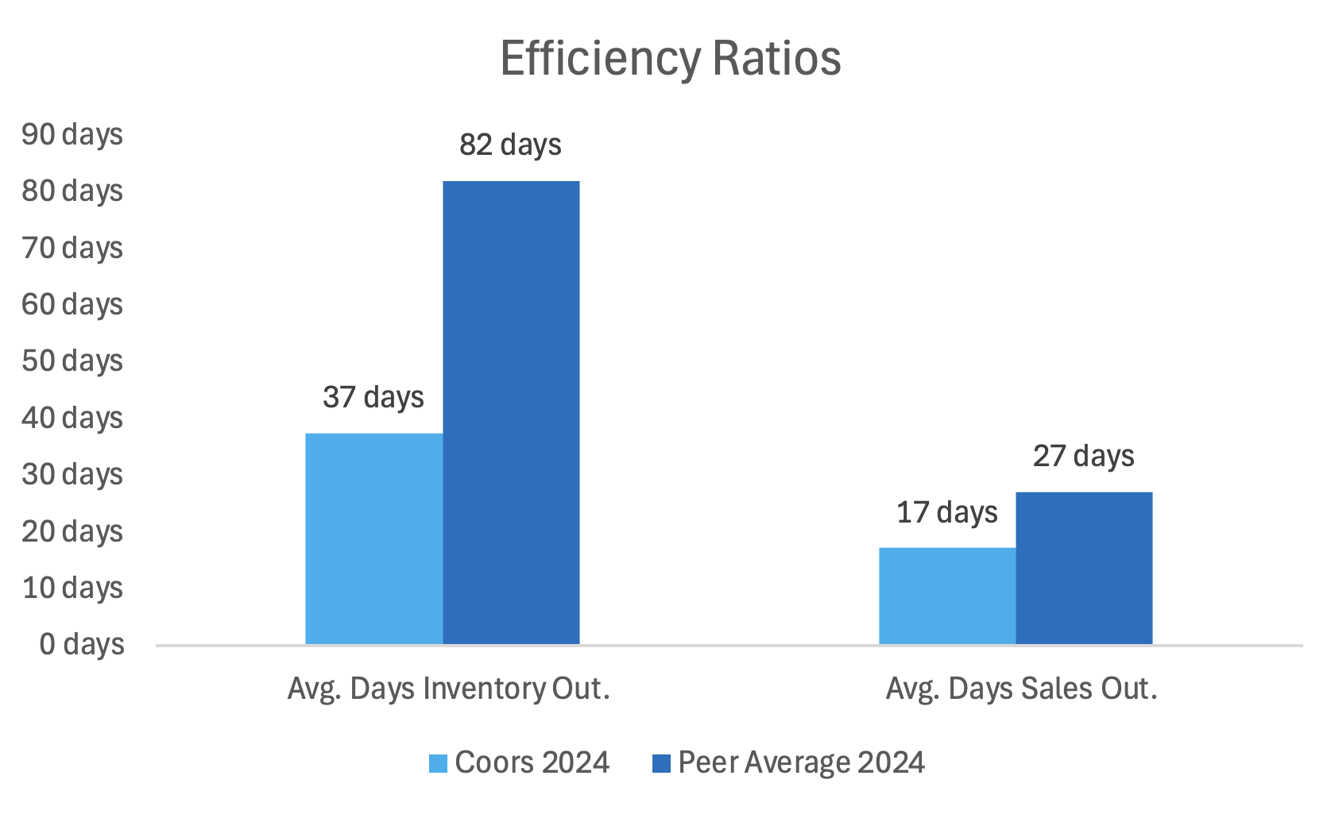
Financial Performance 2
Brand‑heavy Balance Sheet with significant PP&E exposure
Superior working‑capital efficiency vs peers (2024)
Notes:
- Intangibles dominate: Other intangibles ~46.8% of total assets — the single largest asset class, indicating the business is heavily brand‑ and IP‑driven. ******Implications for strategy and risk: heavy exposure to intangibles and brand value makes Molson Coors sensitive to shifts in consumer preference and to impairment risk if premium momentum stalls;
- Significant fixed assets: Gross PP&E ~34.7% shows meaningful capital investment in production and distribution.
- Goodwill material but smaller than intangibles: Goodwill ~21.4% reflects past acquisitions and acquisition premium.
- Accumulated depreciation reduces net PP&E: Accumulated depreciation ~‑16.9% is a contra‑asset; net PP&E ≈ gross PP&E minus accumulated depreciation.
- Low current liquidity: Cash & short‑term investments ~3.7% and receivables ~3.2% mean a small share of assets is immediately liquid.
- Working capital small: Total current assets ~10.9% — the balance sheet is skewed toward long‑lived and intangible assets.
******The “Other Intangibles” section of their Balance sheet consists of primarily trademarks/brand names (strong part of their entire business), customer/distribution relationships, licenses (for their beer and drink recipes) and SOFTWARE.
The software is what ties into the efficiency ratios. A significant amount of capital has been invested in developing technology for their production and distribution of their products, namely supply‑chain optimization and demand forecasting, brewery and distribution automation, and commercial analytics/consumer insights. These are all meant to both reduce operating expenses and increase efficiency in their distribution. And this has led to…..
Superior inventory management: Coors turns inventory in ~37 days, less than half the peer average (~82 days).
Faster cash conversion: Receivables convert in ~17 days vs ~27 days for peers.
Net effect: Stronger working‑capital efficiency supports free cash flow and funds dividends/strategic investments.

Slide 5


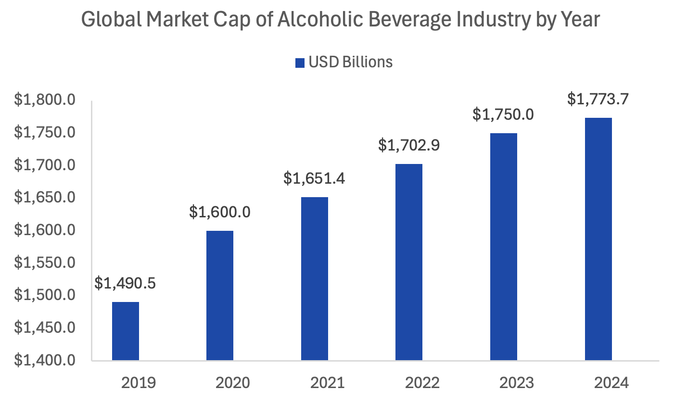
Industry Overview
RTD (Ready-to-Drink) products are surging
On-Premise vs. Off-Premise
High Input Costs
“Brand Premiumization”
Push for 18–30-year-old
Demographic
CAGR = 3.5% from 2019-2024
Notes:
- Ready to Drink= Premade cocktails that you can buy as a single product, flavored seltzers, things like that
- On-Premise are bars and restaurants, off-premise are homes and e-commerce
- High Input Costs= Inflation, higher cost of raw materials, and shipping costs increased, especially recently with tariffs.
- Brand Premiumization= Consumers drink less volume but spend more per unit, trading up to higher‑quality brands
Consumer Trends= Move towards low calorie, no-alcohol beverages, RTD products, Premiumization as opposed to volume, moving to more of an online presence to capture 18-30 year-old demographic
Market cap supposed to grow to 3.1 trillion 2030

Slide 6
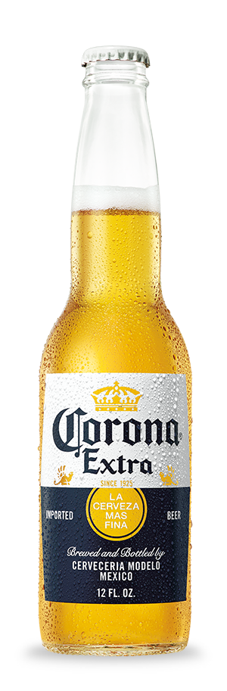
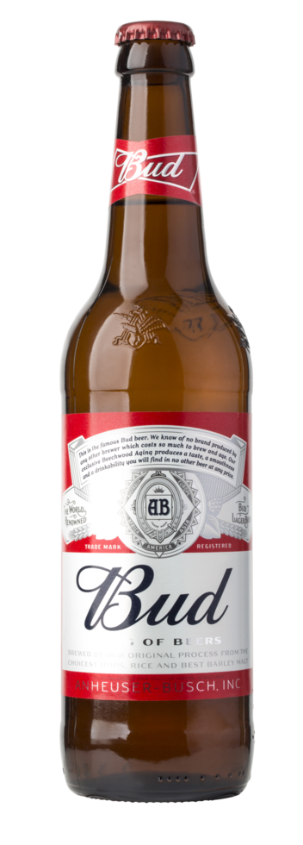
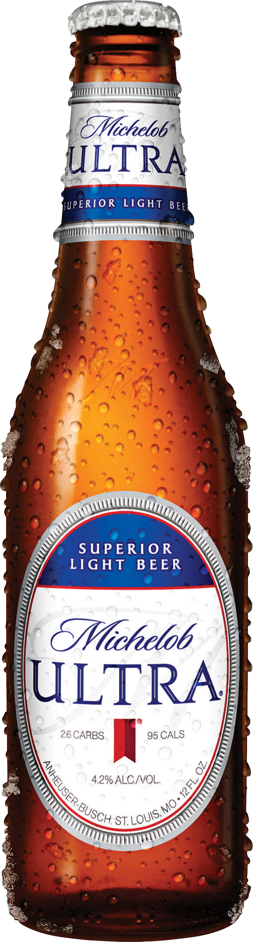
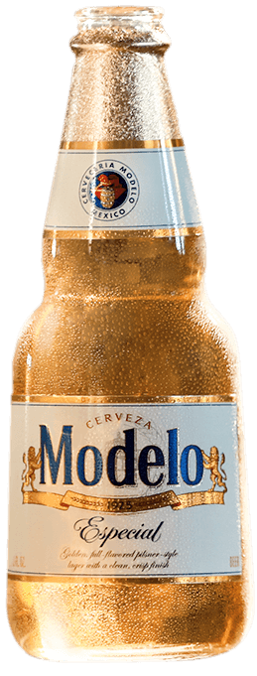
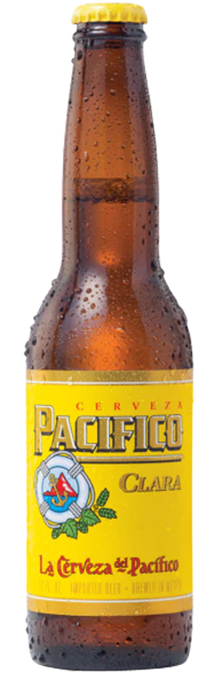
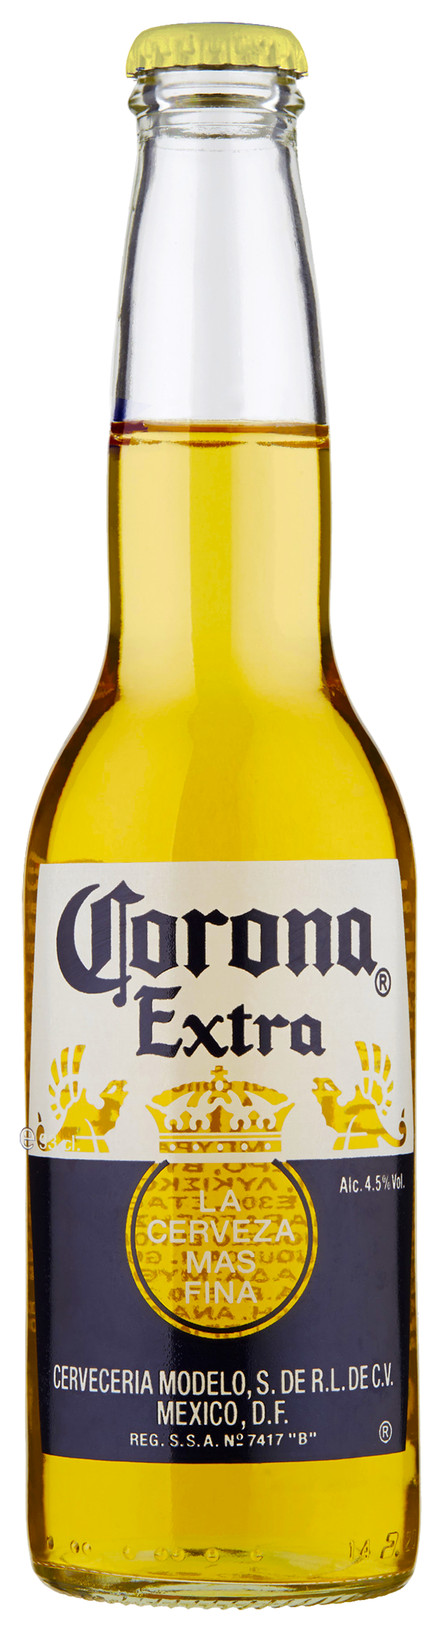
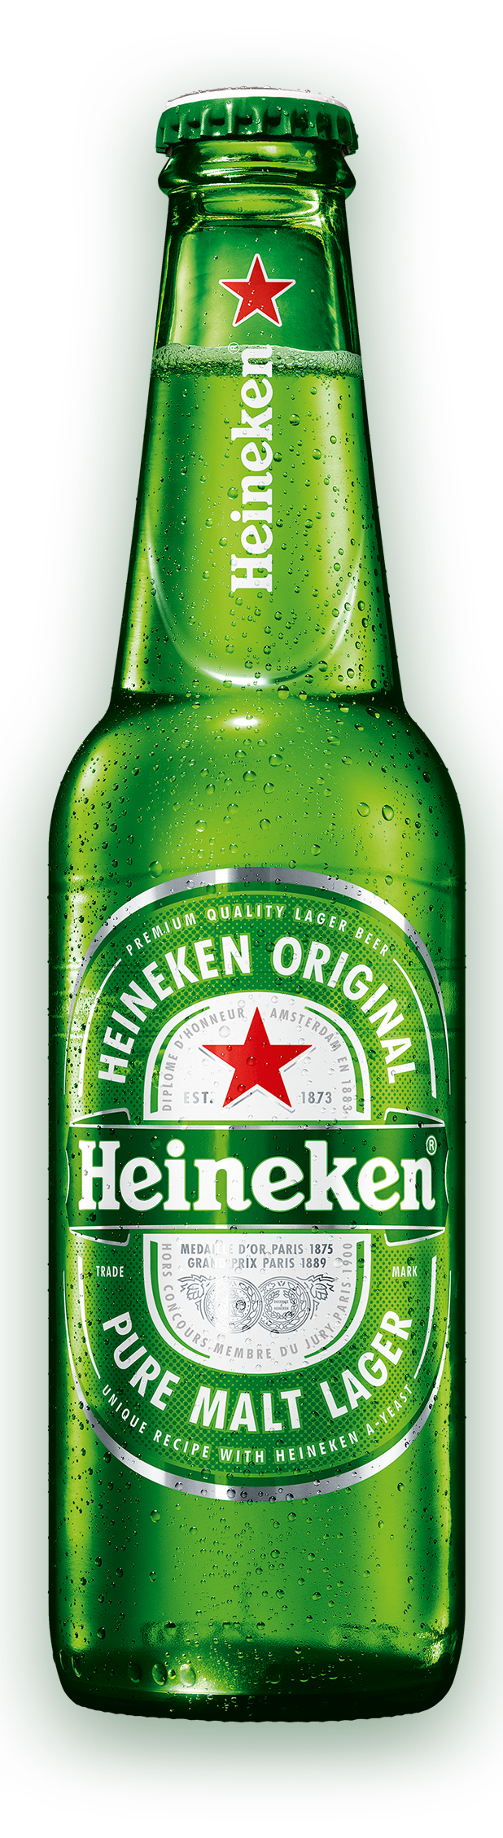
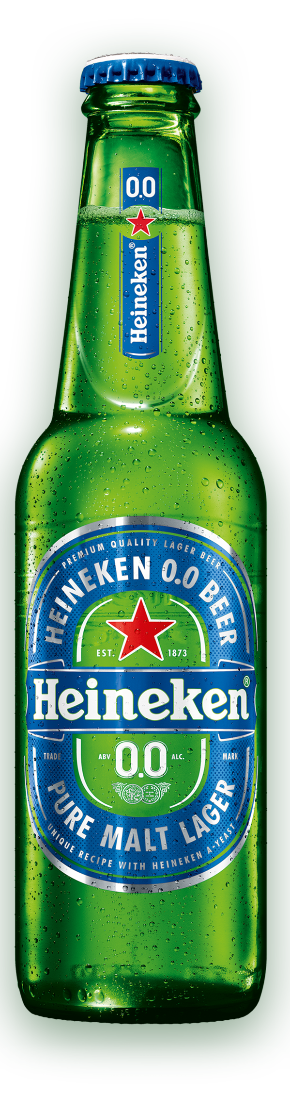
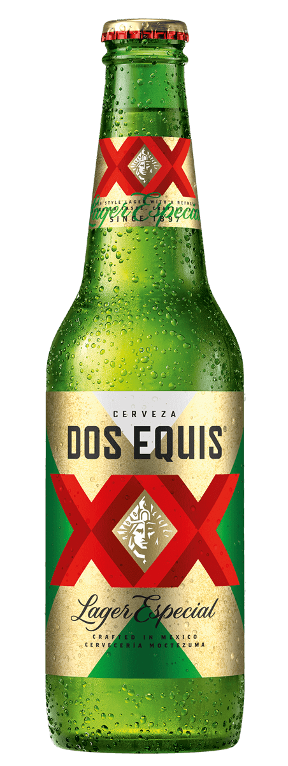
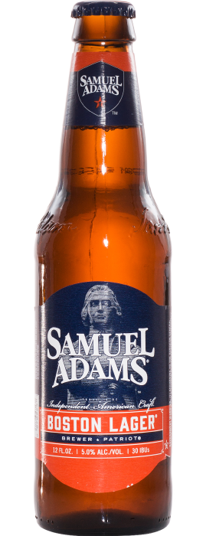
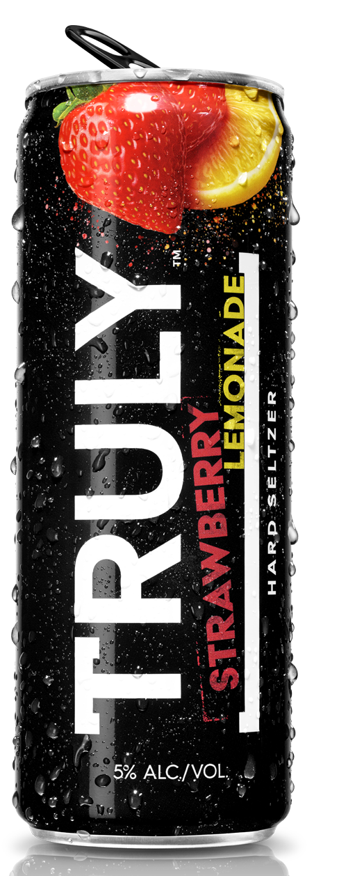
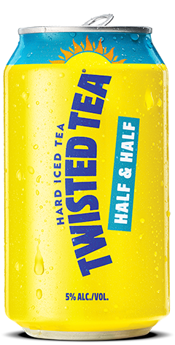
Competitors
  1. Anheuser-Busch
  3. Constellation Brands
  2. Heineken
  4. Boston Beer Co.
Notes:
If mentioned in the ratio analysis, you can breeze through this slide. Same companies as peer group for the ratio analysis.
- Anheuser-Busch InBev= Budweiser, Bud Light, Michelob Ultra, Stella Artois, Busch Light, Natural (Natty) Light. *****Industry leader, standard for brewing
- Heineken= Heineken, Heineken 0.0%, Heineken Silver, Moretti, Edelweiss. **** Industry standard for 0% non-alcoholic drinks
- Constellation Brands= Modelo, Corona, Pacifico, Kim Crawford Wine
- Boston Beer Company= Samual Adams Beer, Twisted Tea, Angry Orchard, Truly, Hard Mtn Dew
Mix of legacy brands (Anheuser-Busch) and emerging brands trying to diversify their product line (Boston Beer)
***Note= The production time for a hard seltzer is nearly half the time as beer, taking into consideration fermentation. Costs are less than beer as well. Shorter days in inventory.
^^^With this, many of these companies are looking to move into the seltzer and healthy beverage arena, if they haven’t already

Slide 7

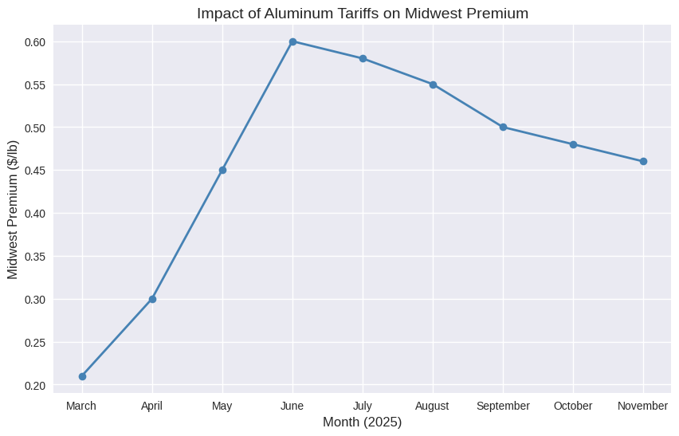
Key Event: Tariffs
Aluminum Supplier: Ball Corp
Production of Cans in Golden, Colorado
2025 Tariffs Effect:
DCF Impact for COGS Forecast
DCF Impact for Conservative Growth Rate
Notes:
- *** Overall point to get across: Tariffs on the import of aluminum have affected our forecast of COGS and the growth rate in our TV Perpetuity Growth projection. They produce all their cans in Golden, Colorado, and their supplier for the aluminum is Ball Corp, based out of Colorado as well. Molson is their biggest client along with Coca Cola and Pepsi
- March 2025: U.S. imposed a 25% tariff on aluminum imports from Canada, which supplied ~39% of U.S. aluminum.
June 2025: Tariffs doubled to 50%, causing the Midwest aluminum premium to jump from $0.21/lb to $0.60/lb (a 190% increase).
Chart is showing that the price of aluminum is leveling off, but still double what it was pre-tariffs
This has forced Molson to raise prices on their products by 3-4% globally.

Slide 8
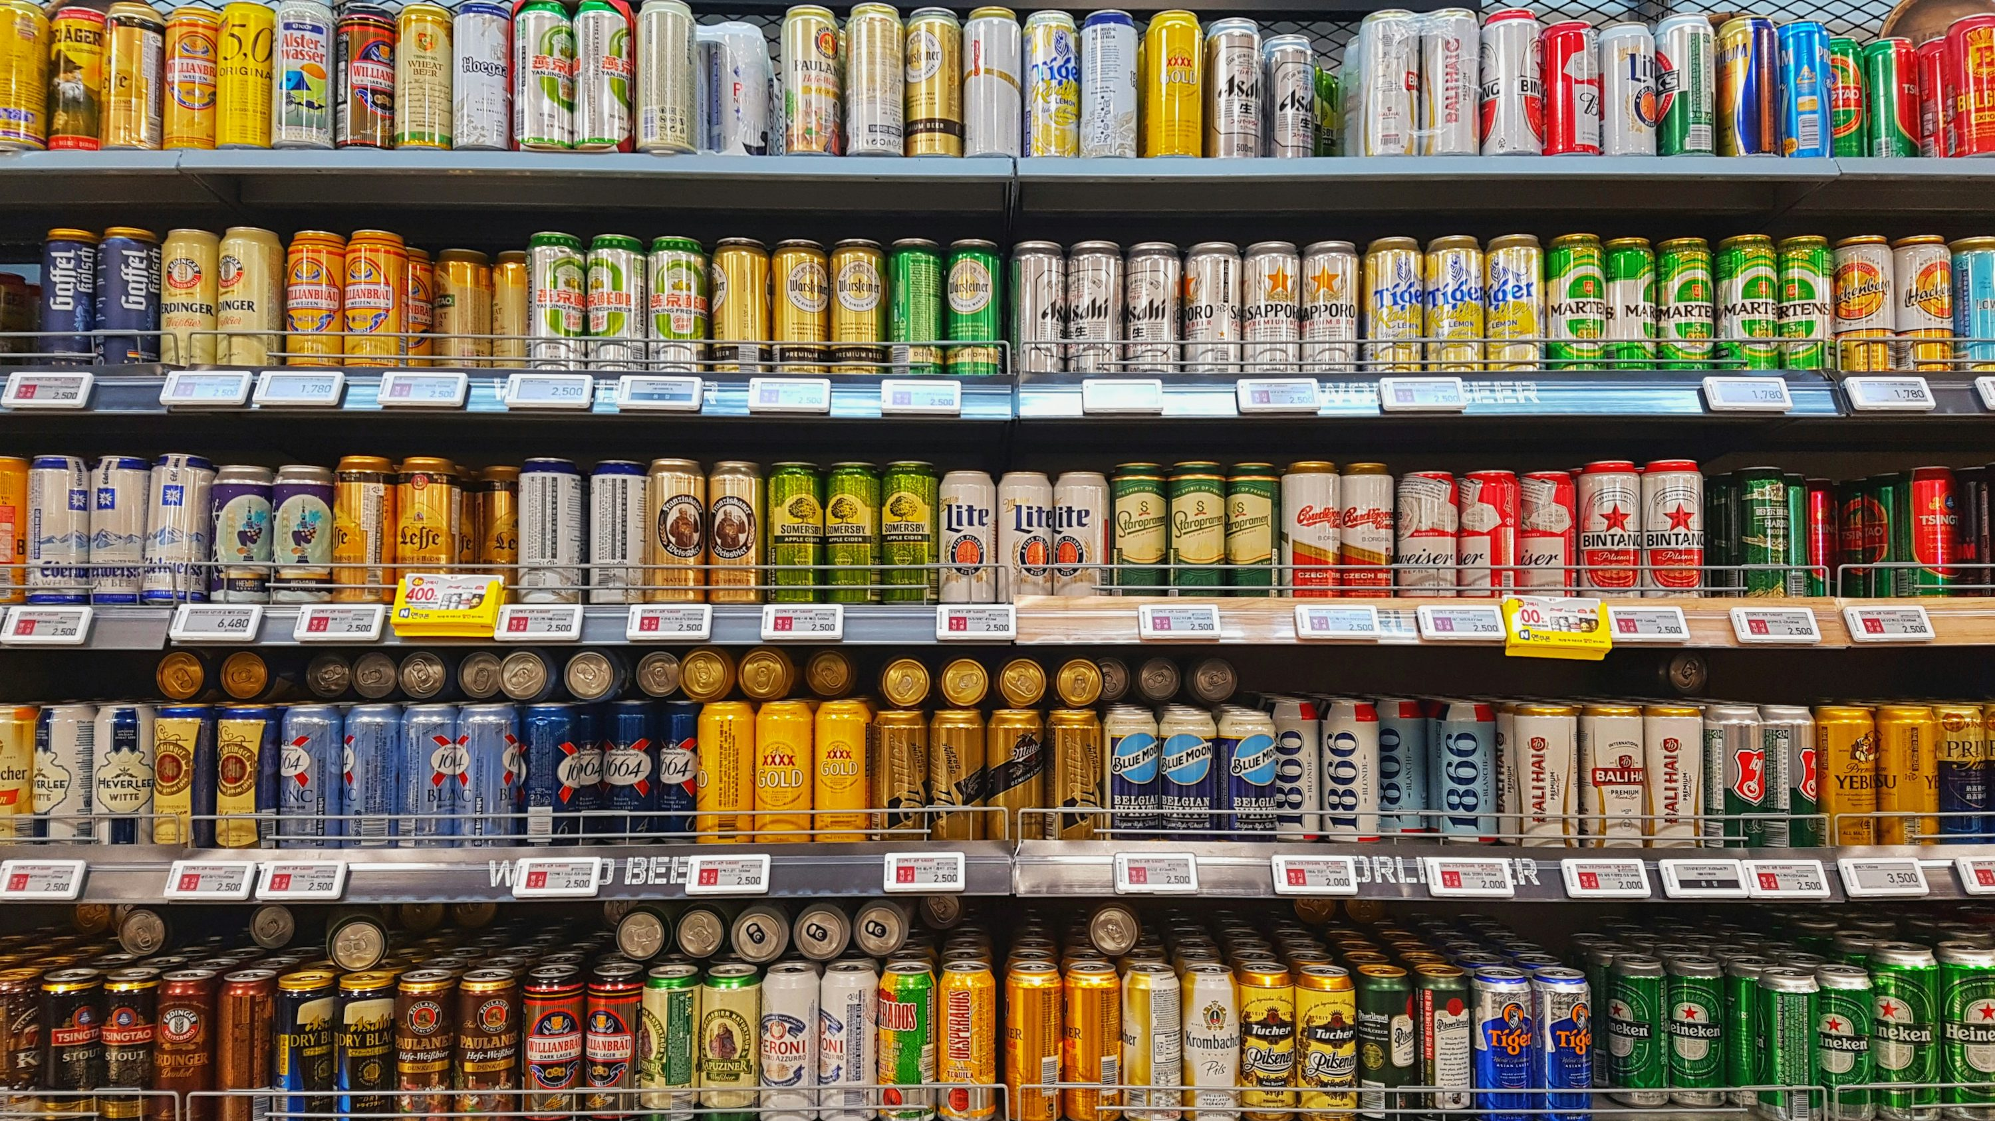
DCF Context
Legacy Company
Steadily Growing Industry
Tariffs Impact
Macroeconomics Description:
Perfect Competition

Slide 9
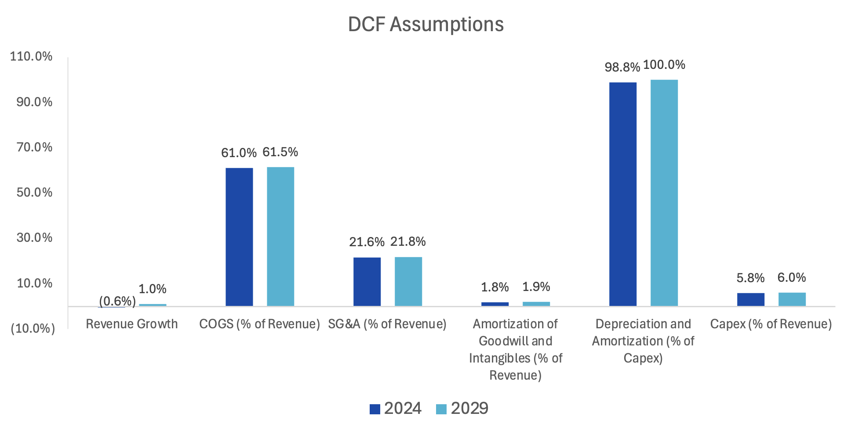
DCF Assumptions
  Terminal Growth Rate = 1.5%
  Tax Rate = 25%
  RFR & MRP = Damodaran
Notes:
*** Start with the graph= Overall theme is that we were conservative with our outlook, but note that our COGS is stabling above the pre-tariff rate, depreciation and capex increasing due to them expanding into the seltzer and energy drink sector. Revenue saw a decline in 2024 because of Volume Softness: Molson Coors experienced a 6.4% year-over-year decline in sales volumes in Q4 2024, continuing a multi-year trend of lower product movement
Tax rate is 25%, RFR (risk-free rate) and MRP (market risk premium) from Damodaran, used his website for many hard-coded values in our model

Slide 10
DCF Justifications
  Revenue Growth (0.6%) →1.0%
  Recovery from 2024 to Industry Trend
  COGS 61.0% → 61.5%
  Level Off to Post-Tariff Highs
  SG&A 21.6% → 21.8%
  Increase for Brand Investment & Marketing
  Amortization Goodwill 1.8% → 1.9%
  Straight-Line Amortization & No M&A
  D&A 98.8% → 100%
  Capital Intensity & Long Asset Lives
  CapEx 5.8% → 6.0%
  Brewery & Packaging Upgrades

Slide 11
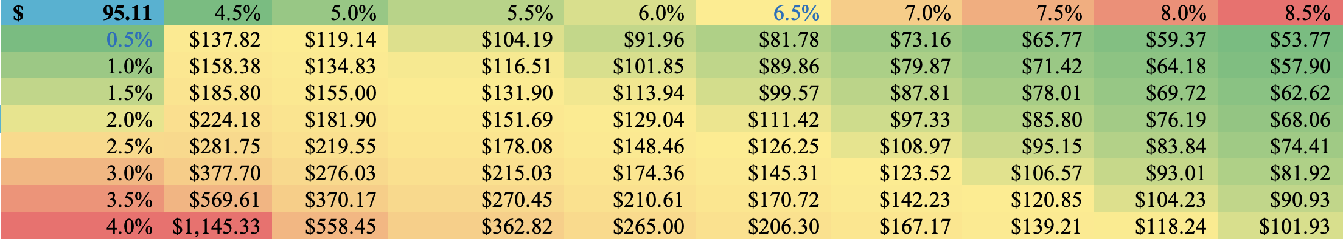
DCF Sensitivity Analysis
  PG Share Price
  WACC
  Terminal Growth Rate
Notes:
***** Very Quick Slide, hit these 2 points and move on:
Share price is highly sensitive to WACC:
A 1% increase in WACC (e.g., 7.5% → 8.5%) drops valuation by ~40%.
A 1% decrease boosts valuation by ~45%.
Terminal Growth Rate has moderate impact:
Increasing TGR from 2.5% to 4.0% raises valuation by ~20–25%.
Lowering TGR to 1.0% compresses value by ~15–20%.

Slide 12
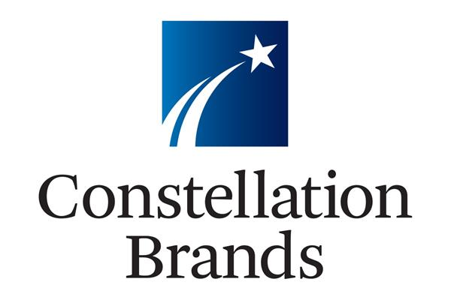
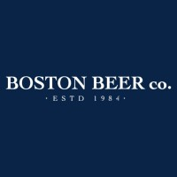




Relative Valuation: Selecting Comps
Main considerations:
Business Mix
  Beer over spirits
  Physical brewing and distribution channels
Legacy Companies
Size
Other Factors:
Footprint
  Global or at least multi regional
Our Comps:
Constellation Brands, Inc.
The Boston Beer Company, Inc.
Carlsberg A/S
Asahi Group Holdings, Ltd.
Anheuser-Busch InBev SA/NV
Heineken Holding N.V.

Slide 13

Relative Valuation: Multiples
  EV/Sales
  EV/EBIT
  EV/EBITDA
  Forward PEG
  Forward P/E
  Price-to-Book
  Effective for Low Margin Industries
  Reflects Core Operating Capacity to Generate Profits
  Widely Used in M&A, Operational Efficiency
  Metric for Mature, Dividend-Paying Beer Companies
  Prices the Ongoing Cost Savings and Buyback-Driven EPS
  Useful for asset heavy, balance sheet driven businesses
Notes:
EV/Sales= In industries where net margins are thin (like beer, grocery, airlines), earnings can swing wildly due to small changes in costs. Sales, however, tend to be steadier, making EV/Sales a more reliable benchmark.
EV/EBIT= EBIT excludes interest and taxes, isolating the company’s ability to generate profit from operations.
EV/EBITDA= Standard for beverage and manufacturing sectors: EBITDA strips out non-cash charges and financing effects, offering a cleaner view of cash-generating ability.
Forward PEG= Balances price and growth: The PEG ratio takes the P/E multiple and divides it by expected earnings growth. This adjusts valuation for how fast a company is expanding.
^^^^Normalizes for widely differing EPS growth rates
Forward P/E= Forward P/E is useful for mature, dividend-paying firms because it ties valuation directly to the earnings stream that supports dividends and long-term investor confidence.
Price-to-Book=

Slide 14

Relative Valuation: Results
Notes:
Bottom-Line: Even with selecting conservative multiples from our comps group, we have steady at/above share prices, reinforcing our forthcoming “buy” recommendation.

Slide 15

Football Field Chart
Implied Price-per-Share is Above Current Stock Price in Numerous Scenarios
BUY Recommendation

Slide 16

Conclusion/Recommendation
Our Model Suggests Undervalued Equity
Strong Buy Recommendation
Bottom-Line: Legacy Company in Growing Industry

Slide 17
Questions?

Slide 18
Thank You!

Slide 19
Extra Info Slide
Founded in 2005 through a merger: Molson of Canada and Coors of the U.S. combined to form Molson Coors Beverage Company.
Major acquisition of Miller Brewing: In 2016, Molson Coors acquired the full global Miller portfolio for ~$12 billion.
Large scale operations: In 2024, revenue was ~$13.7 billion, net income ~$1.1 billion, with ~16,800 employees worldwide.
Rebranded to Molson Coors Beverage Company in 2019: The company officially retired the “Molson Coors Brewing Company” name to signal its strategy of expanding beyond beer into other beverage categories like hard seltzers, spirits, and non‑alcoholic drinks
Volume challenges: In early 2025, worldwide sales volume dropped 14.3%, driven by weakness in both Americas and EMEA/APAC
Their Coors Light cans turn blue when refrigerated because of thermochromic ink, it turns blue when exposed to temperatures around 38-46 degrees Fahrenheit

