Slide 1

Nourish LA
By: George Tupy

Slide 2
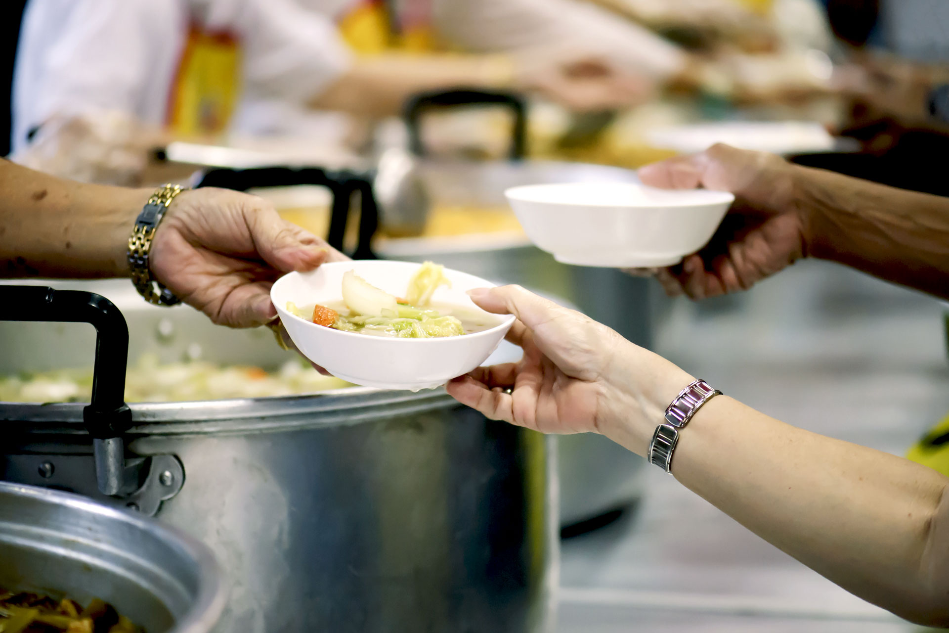
Introduction
Chosen Insecurity: Food Insecurity and Hunger Relief
Definition: “Understanding how people struggle to access enough nutritious food and how food banks, meal programs, or community gardens respond to those needs.”
  Significance: Food insecurity threatens health and opportunity, while hunger relief programs restore dignity and strengthen communities.
Our Scope: Greater Los Angeles Area
Key Affected Groups: Low-income households, single-parent families, racial and ethnic minorities, rural communities.

Slide 3
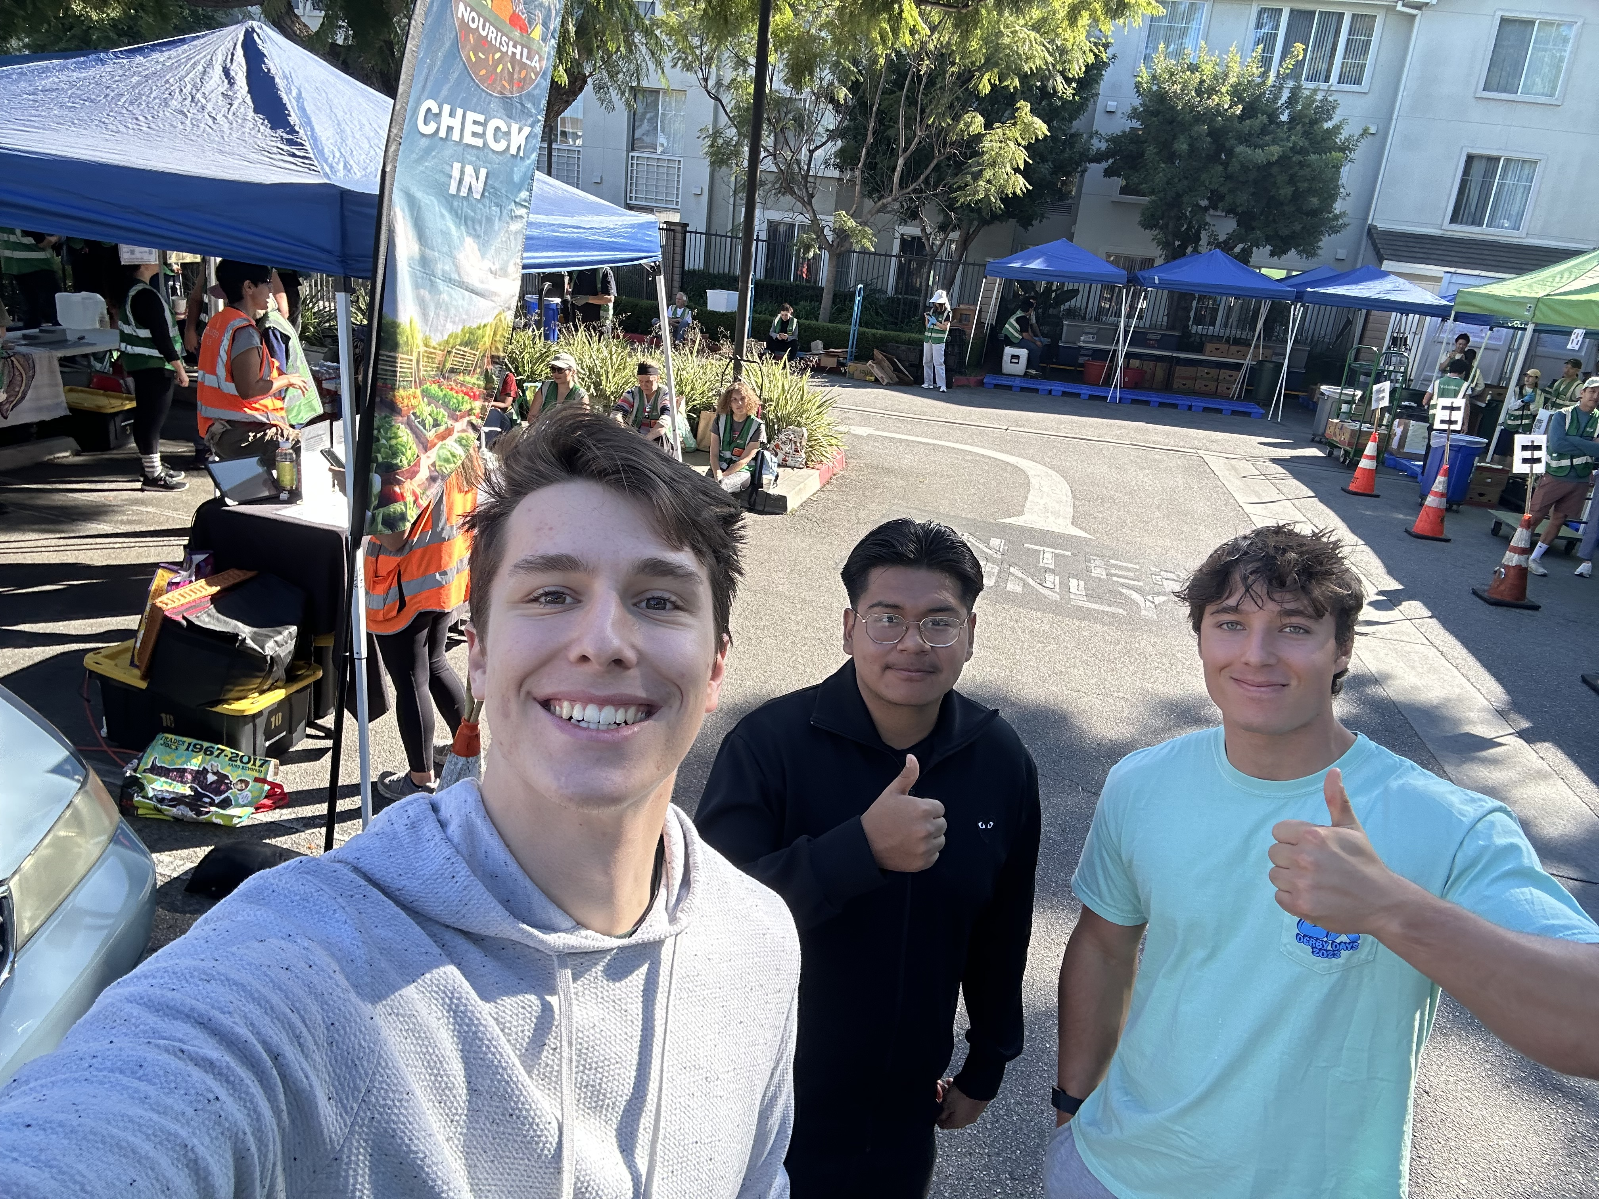
About Nourish la
Nourish LA — a grassroots nonprofit fighting hunger and food waste across Los Angeles.
Mission Statement: “To nourish neighbors by rescuing surplus food, promoting urban agriculture, and building resilient communities”
How Do They Address this Issue?: They get food from “Partially from the food recovery app, partially from Westside Food Bank, and then also from a third-party company called Food Cycle [whose job is to] pick up food and recover it and get it back out to non-profit organizations.”

Slide 4

Structure and Leadership
Democratic Leadership Structure: Leadership is based on decision-making, open communication, and collective responsibility.
  For Nourish LA, collaboration and community engagement is central to their operations.
Consultative Leadership Style: Input from team members is encouraged, but the leader makes the final decision.
  Nourish LA is run by Natalie Flores-Blackner, the Founder and CEO of the organization, and because of their size, all decisions are eventually made by her.

Slide 5
Organizational Culture
Organizational Culture: Described as supportive of learning, growth, and experimentation, with leaders encouraging new ideas and flexible methods of practice.
Observable Artifacts from Nourish LA:
  Language: Common phrases like “food is a right” and “neighbors helping neighbors.”
  Symbols: Branded sustainable bags for food, compost bins, and colorful signage at every distribution.
  Ceremonies: Volunteer appreciation days.
Strengths | Weaknesses
Empowerment of Volunteers | Lack of Formal Accountability
Openness to New Ideas and Creative Solutions | No Standardization Process
Diversity of People and Thought | Slower Decision-Making due to Consensus Building
Strong Purpose and Drive with Their Mission | Burnout Risk During Periods of High Demand

Slide 6
Staffing and Human Resources
High Volunteer-to-Staff Ratio: Volunteers drive core operations like food distribution, pantry setup, and outreach, while a small leadership team oversees strategy and logistics.
Highly Effective Volunteers and Staff: Nourish LA is “very proud of the work their volunteers do,” and their staff coordination makes “every event run efficiently.”*
HR Challenges Include: Volunteer retention in high demand periods, budgeting limitations, and constrained performance evaluation systems.
*Per our interview with Jess Castillo and volunteer staff

Slide 7
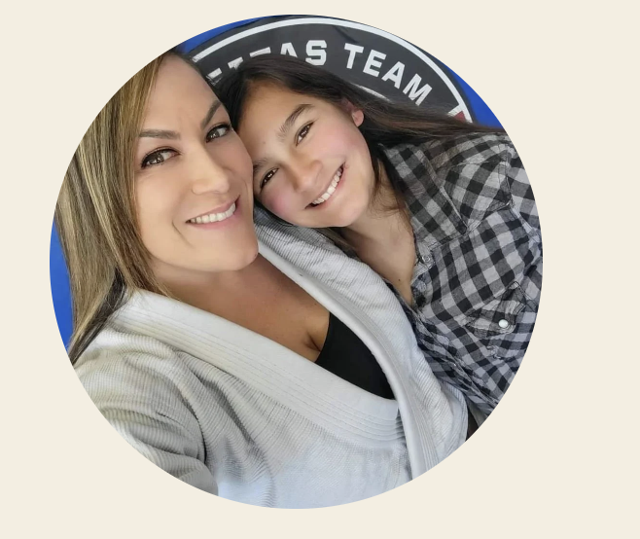
Key Challenges
Jess Castillo, Operations Manager: “Right now our biggest challenge is space and capacity.”
  “We actually have a couple of refrigerators and a freezer, but again, if we had our own space, we'd be able to have double that capacity and we'd be able to feed more people.”
  “On Sundays alone, we feed approximately 1000 people every Sunday.”
Nourish LA Interview .m4a

Slide 8

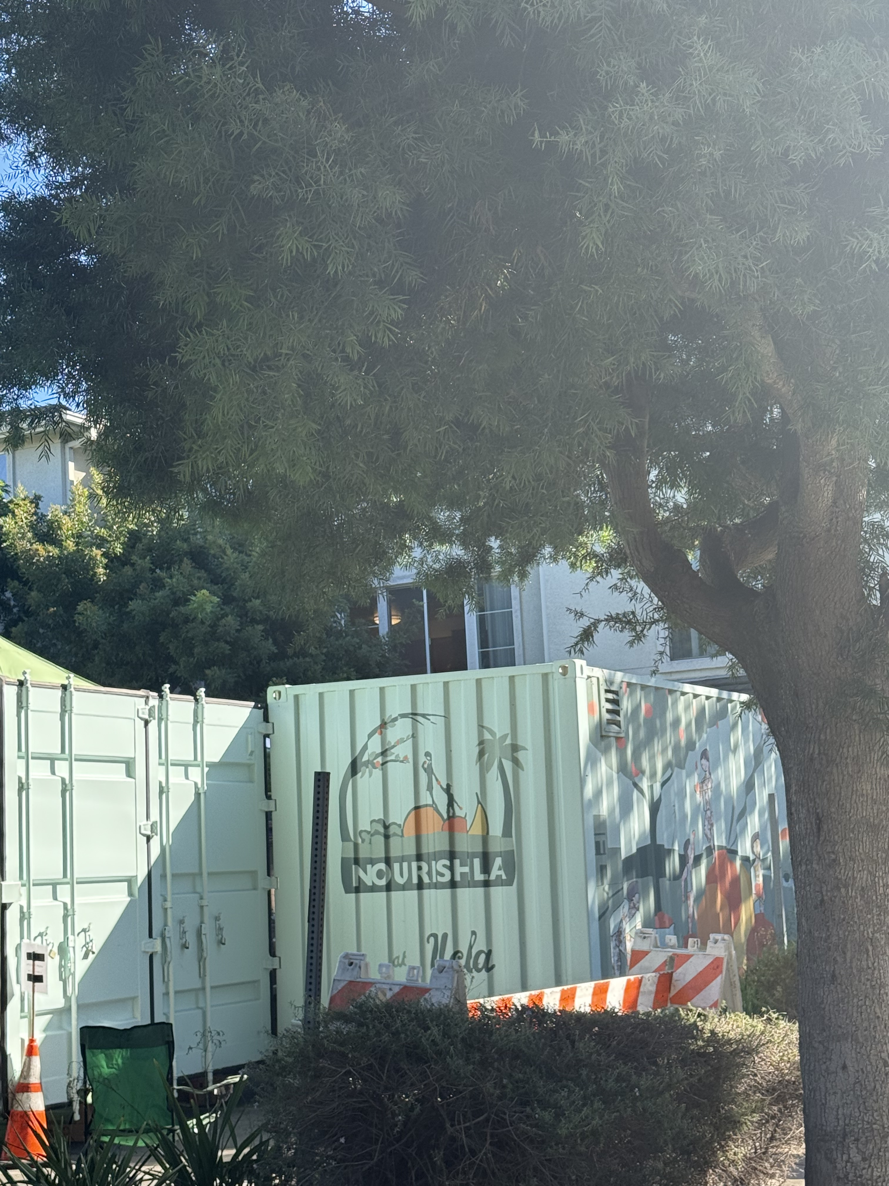
Our Proposed Solution
Insights from Organizational Behavior Chapter 14: Emphasis on strategic partnerships that will help overcome physical limitations.
Strategic Alliances: Textbook mentions how these can increase operational efficiency and decrease overhead costs.
The California Endowment – Center for Healthy Communities (Downtown LA): Our proposition is to partner with this Center, which will give Nourish LA a permanent space to run their operations with no cost to them.
  Built specifically for non-profits, offers office space, outdoor distribution center, and technological support.

Slide 9
Implementation Plan
Apply for permanent, weekly access to use this space.
Use strategic partnerships and more volunteer manpower to move existing storage units and operational equipment.
Launch Marketing Campaign through social media and website to notify existing demographic of the move.
Reinvent Business Model and Scale: Main distribution occurs at The California Endowment, with pop-ups around the city.
Bring to life Jess’s vision: “A new space would provide us opportunities to have workshops and educational pieces for the community and schools to have them bring them in and teach people how to compost and how to garden and how to cook.”

Slide 10
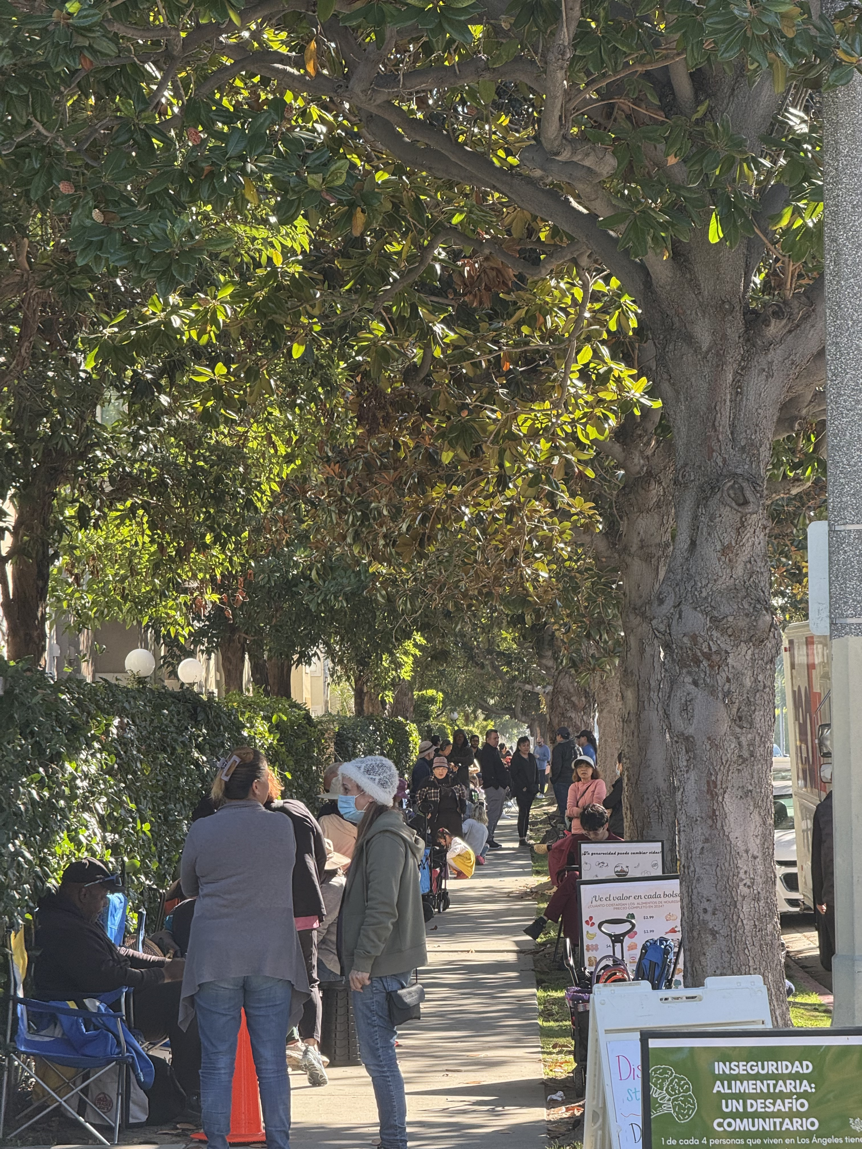
Key Takeaways from our project
Selfless Acts of Service Drive Community Change: Without the continued help of people in LA, this operation could not be possible.
The Need is Real: Image is the line down the street from Sunday Distribution, 30 minutes before their truck unloaded.
Nourish LA’s Ability to Scale: If they get through their obstacle of a permanent space to operate, their business model suggests real ability to scale.

Slide 11


