Slide 1



TopSports
Topgolf Expansion Model
By:
George Tupy, Marketing Director
Marketing Campaign

Slide 2
Table of contents
1
2
3
Introduction to our brand
Opportunity Analysis/Strategy
Consumer Insights/Positioning
Overview of our expansion proposition
Competitive Landscape and SWOT Analysis
Our Field Research and Selling Proposition
4
5
6
Communication objectives
Creative Media Strategy
Performance Metrics
SMART Goals and Reach to Target Consumer
Creative Plan and 6 Month Media Campaign
KPI’s and Measuring Our Success

Slide 3


1
INTRODUCTION TO OUR BRAND

Slide 4

Topgolf Overview
Founded in 2000 in England, expanded to the United States in 2005 and is a subsidiary of Calloway Golf.
Our goal: Expand Topgolf’s business model to include Basketball, Soccer, and Baseball.
Expansion will include four variations: Tophoops, Topbaseball, Topsoccer, and Topsports.
Generated $1.81 billion in revenue in 2024.
Mission Statement: “To connect people in meaningful ways through the experiences we create, the innovation we champion and the good we do.”
Notes:
- In 2020, Callaway Golf Company acquired Topgolf for $2 billion, aiming to diversify its offerings and appeal to a broader, younger demographic .
-

Slide 5
2
Competitive Analysis/ Strategy

Slide 6
Problem
opportunity
Topgolf’s revenue has gone stagnant in the years succeeding the Covid-19 pandemic and have seen a decreased market share in their 2024 annual reporting.
Topgolf can diversify their product line and include more sports in their venues, giving them the opportunity to dominate the sports entertainment market.

Slide 7

S
W
Strong brand recognition
Innovative entertainment experience with technological integration
Diverse revenue streams coming from the events, food and beverages, gameplay, and possibly merchandise
Partnerships with brands like Callaway
Vast majority of the revenue share in the entertainment sports market
The cost to build and maintain facilities
High prices to keep margins sizeable
Business model relies on high volume
Expense of franchising to different sports/locations
Injury when playing the sport (high insurance and liability cost)
O
Broader market appeal with new sports
Possible global expansion depending on areas with popular sports
Loyalty program for recurring members
Brand sponsorship possibilities with various sports
Possible brand dilution with so many different sports
Affordable alternatives entering the market
Lack of consumer interest
Cost of technology development for other venues
T

Slide 8
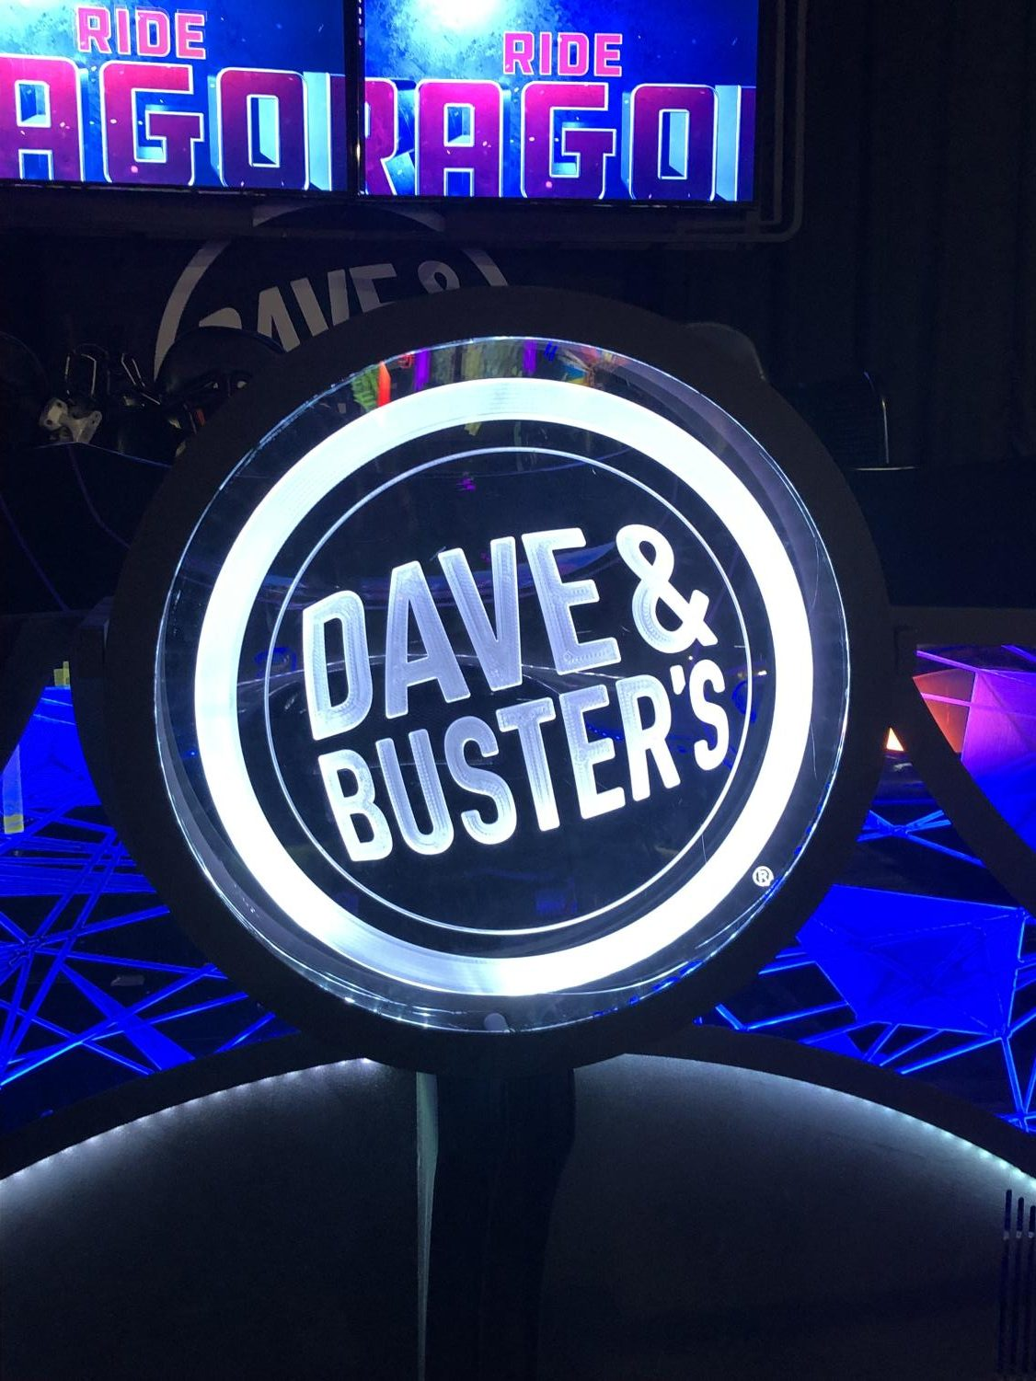



Primary Competition
Dave and buster’s
XGolf
Main Event
Bowlero
Interactive Arcade with Advanced Games
Golf Simulators Venue with Food and Drink
Arcade and Bowling Entertainment
Upscale Bowling Ally and Arcade Venue

Slide 9
3
Consumer Insights/ Positioning

Slide 10
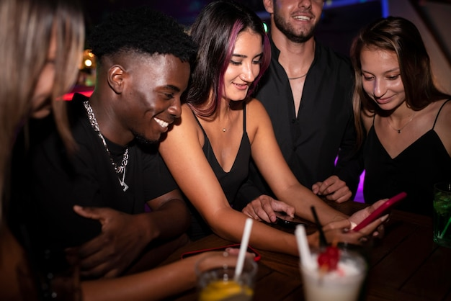
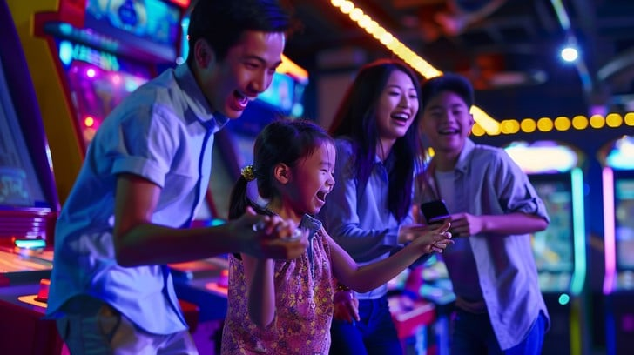
Target Audience
18 to 30-year-olds
Groups of friends seeking an interactive activity
College students, recent graduates, young professionals
Willing to spend <$75 for the visit
The traditional suburban family
Weekend family outings, birthdays, school holidays, team celebrations, casual dinners
Suburban and urban families within driving distance of a Topgolf location
Willing to spend <$200 for the visit

Slide 11
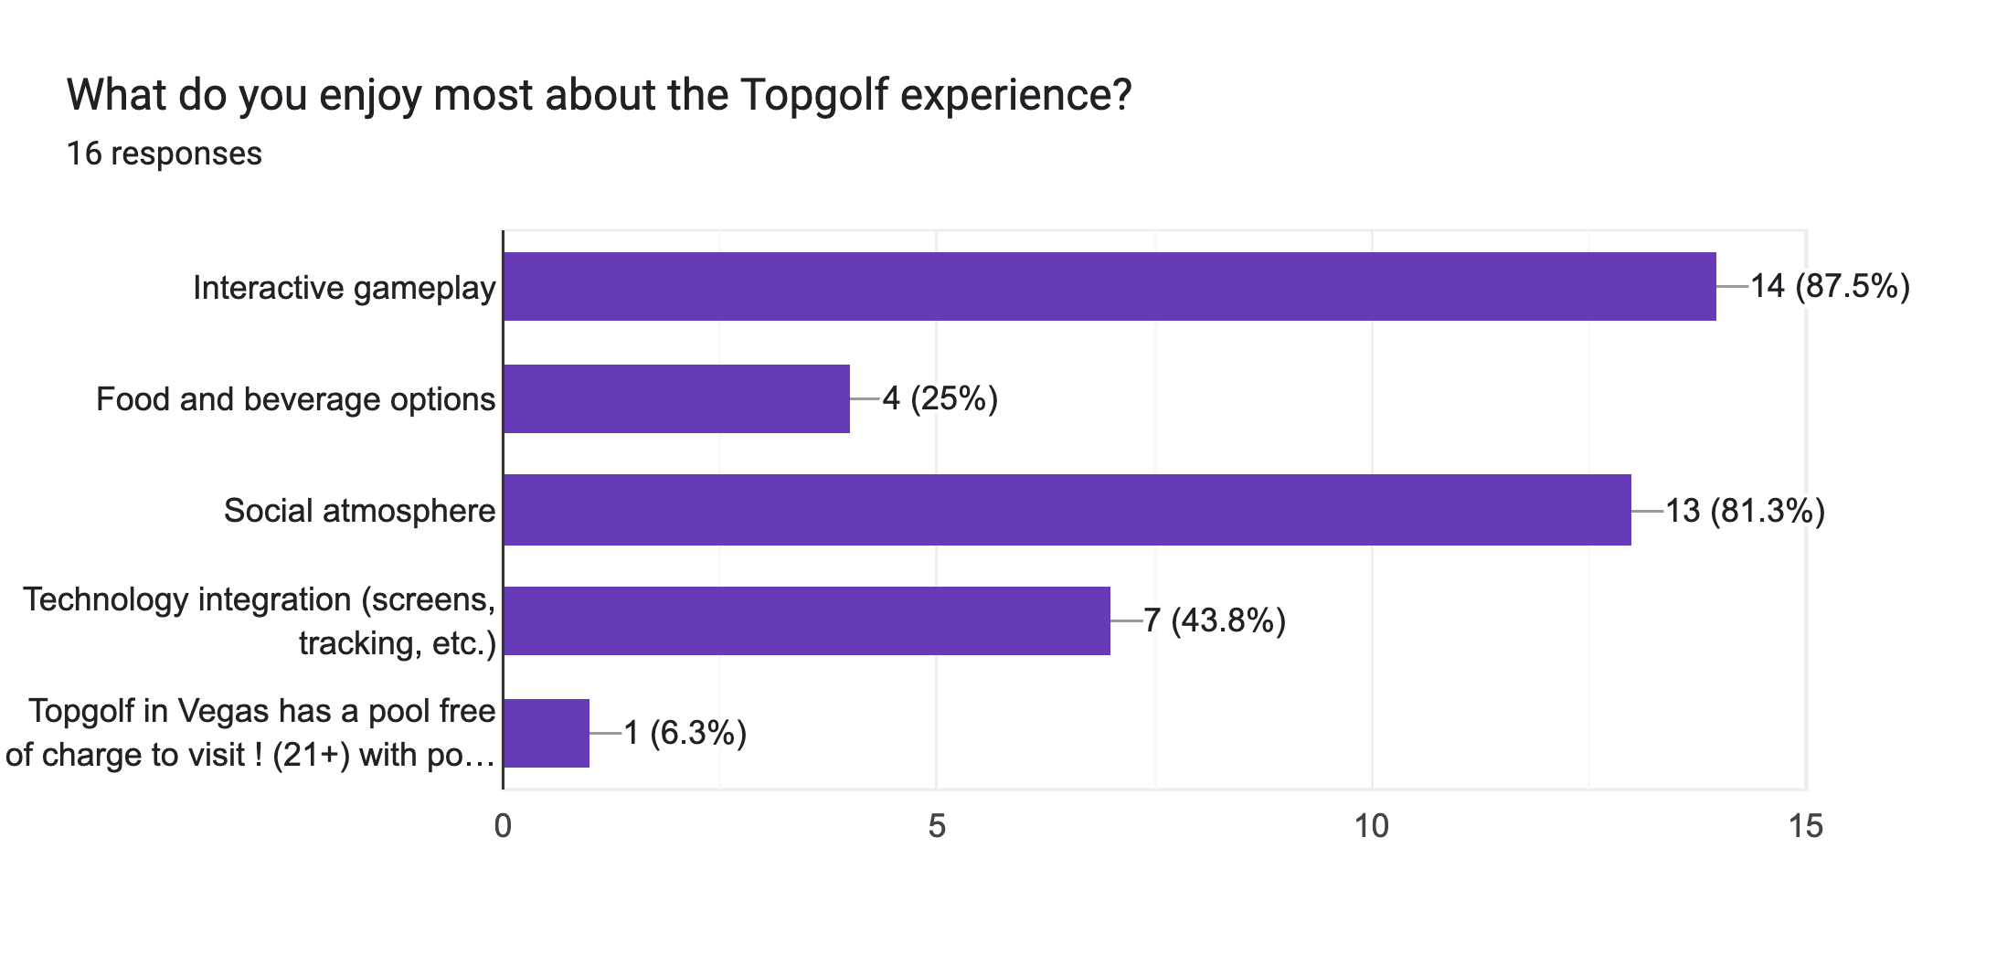
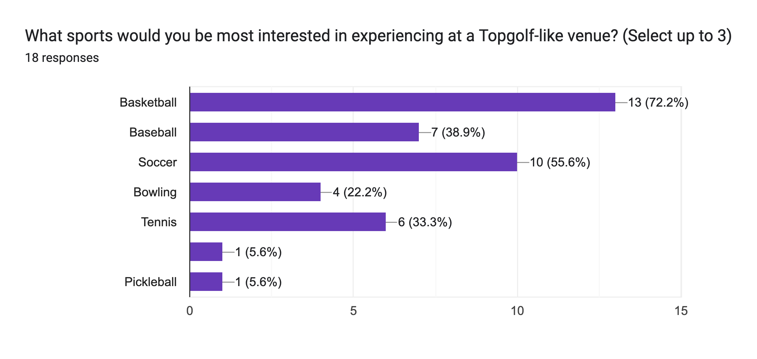
Survey Findings
The majority of our respondents valued the “Interactive Gameplay” and “Social Atmosphere” over other factors such as ”Food and Beverage Options.”
We now know that our customers would like to Basketball, Baseball, and Soccer represented in our expansion, which was reflected in our Overview.

Slide 12
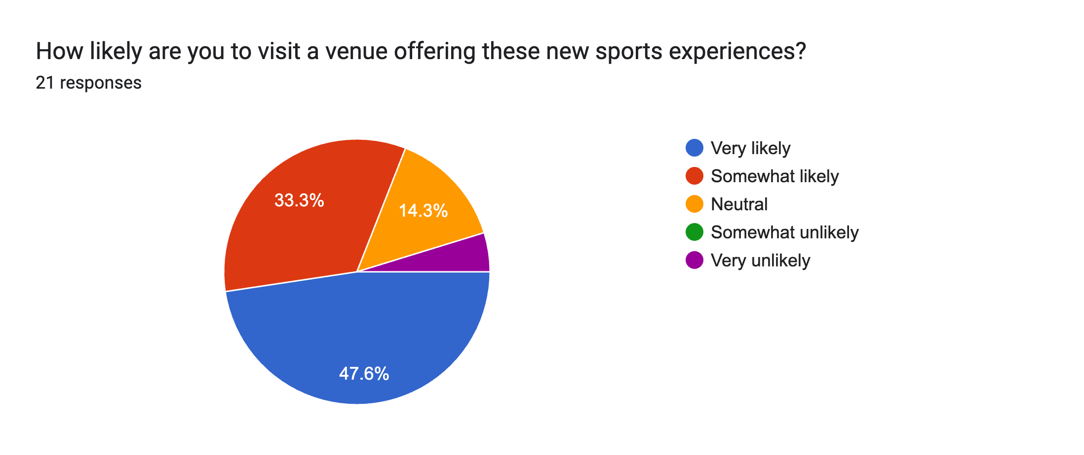
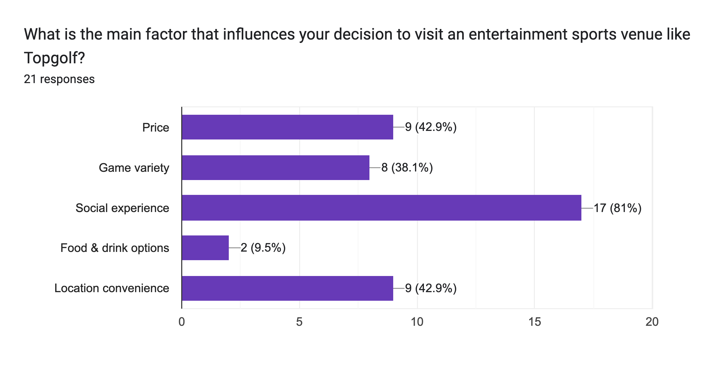
Survey Findings
Our survey participants gave us an overwhelmingly positive reception to our expansion plans.
Interestingly, our customers visit Topgolf locations predominantly for the “Social Experience” and “Location Convenience” over factors such as “Game Variety.”

Slide 13




Unique Selling Proposition
Multi-sport immersion: Offers an innovative experience across golf, basketball, soccer, and baseball—no experience required.
Vibrant social atmosphere: Combines friendly competition with music, food, and drinks in a fun, lounge-style setting.
Tech-driven entertainment: Interactive gameplay powered by cutting-edge tracking technology for all ages and skill levels.

Slide 14
4
Communication Objectives/ Message

Slide 15

SMART Objectives
Launch new standalone locations for Tophoops, Topsoccer, Topbaseball, and Topsports to expand the brand into different sports entertainment markets.
Launch our marketing campaign over the next six months while opening four new locations, one of each proposed sport.
Specific
Track success through increased brand visibility, customer engagement, and strong early customer turnout at each new venue.
Timely
Measurable
Relevant
Supports Topgolf’s overall strategy of blending sports, technology, and social experiences in new and innovative ways.
Attainable
Focus on opening in high-potential markets where there is a strong culture of recreational sports and social entertainment.

Slide 16

Our Message
“Immersive Sports. Unmatched Energy. Endless Memories.”
Our path to reaching our target audience will include communicating the excitement of Topgolf’s brand expansion through bold, energetic messaging that highlights social connection, immersive sports experiences, and accessible fun for all.
Using social media, influencer partnerships, local events, and digital advertising, we will build buzz, drive traffic to new locations, and grow brand loyalty among young adults, families, and sports enthusiasts.

Slide 17
5
CREATIVE MEDIA STRATEGY

Slide 18

Phase 1: Pre-Launch
Athlete Sponsorship
Social Media
Brand Partnerships
Announce athlete partnerships across social media and press.
Release teaser videos of athletes previewing the venues (sneak peeks, short interviews, mini-challenges).
Begin teaser campaigns across Instagram, TikTok, YouTube, and X.
Launch branded hashtags (e.g., #TophoopsChallenge, #TopKickOff).
Influencers start posting “Coming Soon” style content from construction tours.
Announce collaborations with brands like Nike, Easton, and Gatorade.
Launch co-branded “coming soon” promos (e.g., Gatorade Power Play Days).
Goal: Build hype, generate awareness, and tease the experience.

Slide 19
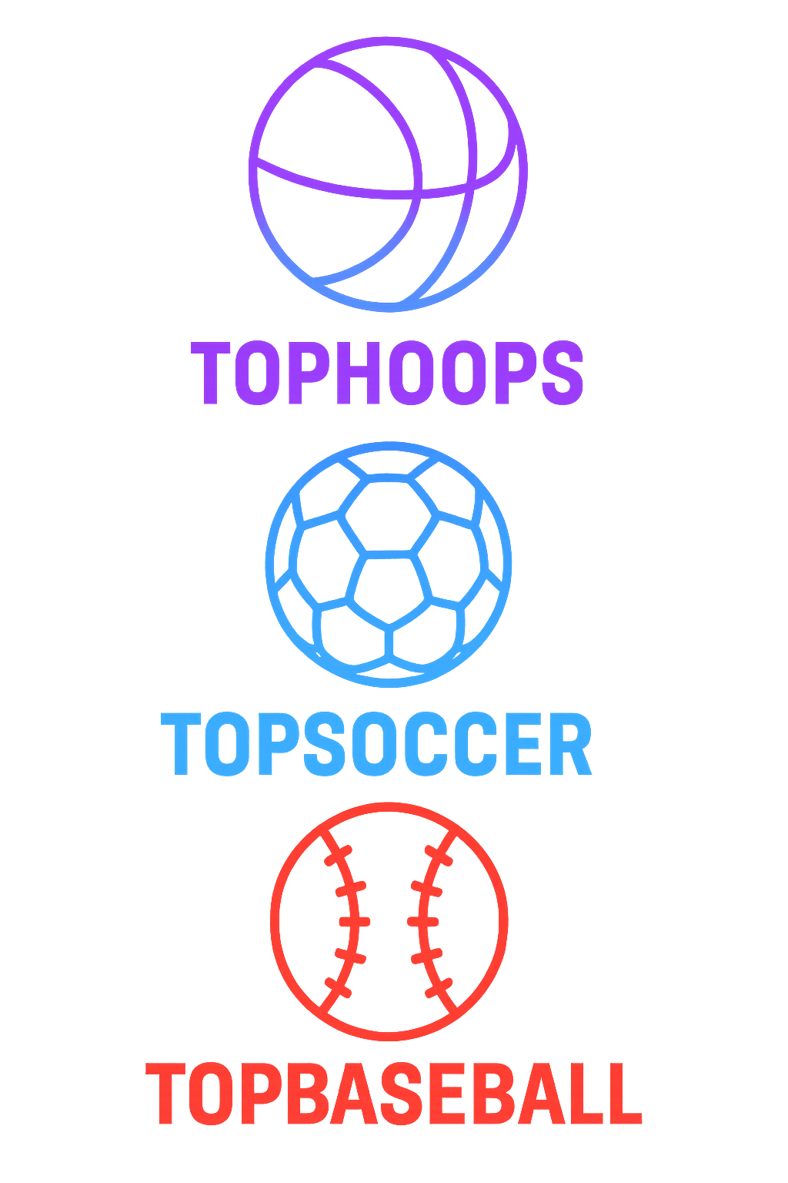
Phase 2: Launch
Athlete Sponsorship
Social Media
Brand Partnerships
Host live athlete appearances at grand openings and opening weekends.
Athletes post live experiences, “first shots/kicks/swings” videos.
Shift from teasers to real gameplay footage from the new venues.
Daily posts: grand opening highlights, customer reactions, UGC reposts.
Continue influencer visits, live Q&A sessions, behind-the-scenes tours.
Launch exclusive merchandise available only at new locations.
Activate partnerships with giveaways (e.g., Nike shoe raffles, Gatorade VIP games).
Custom lines of apparel featuring new logos (e.g., Nike for Tophoops, New Balance for Topbaseball.
Goal: Drive attendance, maximize excitement, and establish the experience.

Slide 20
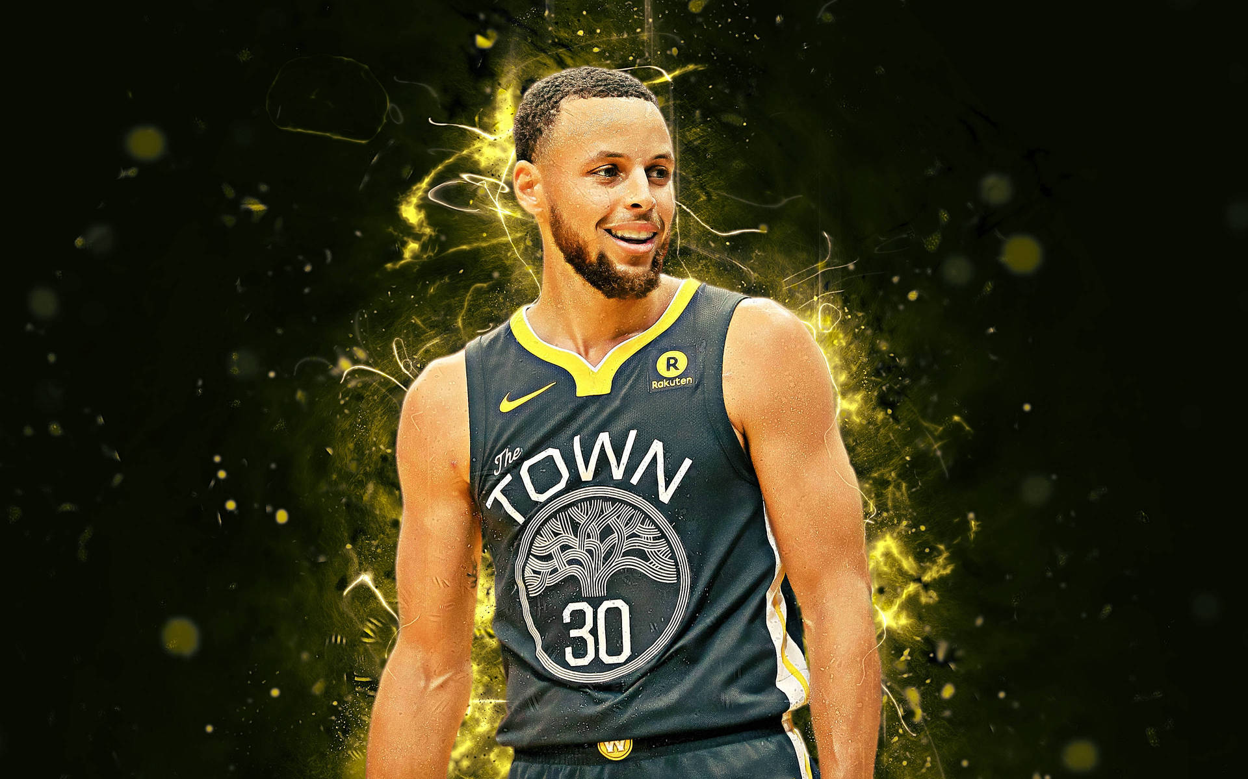



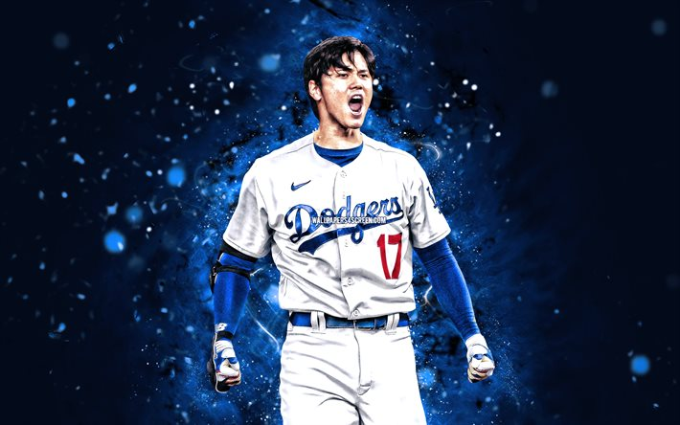

Phase 2: Launch Commercial
Begins with each athlete playing in these futuristic venues. (10sec.)

Slide 21
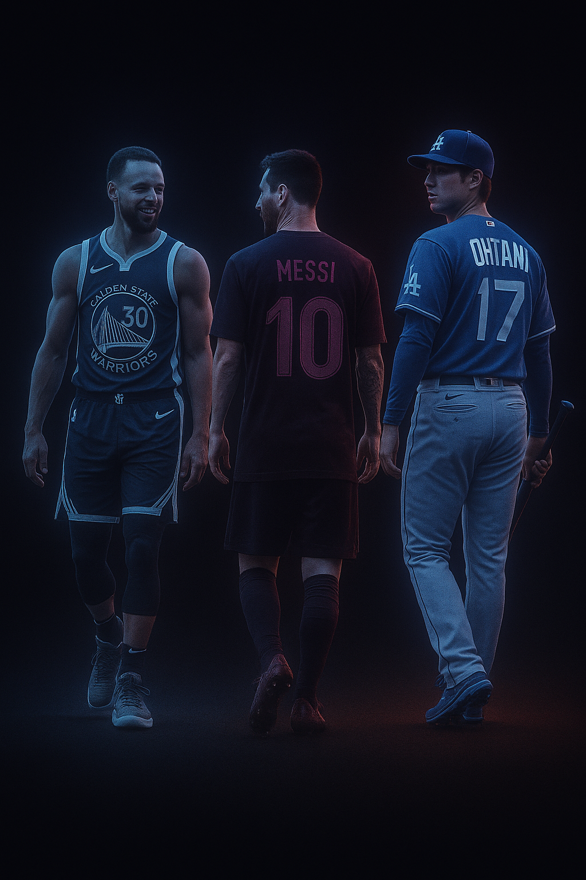
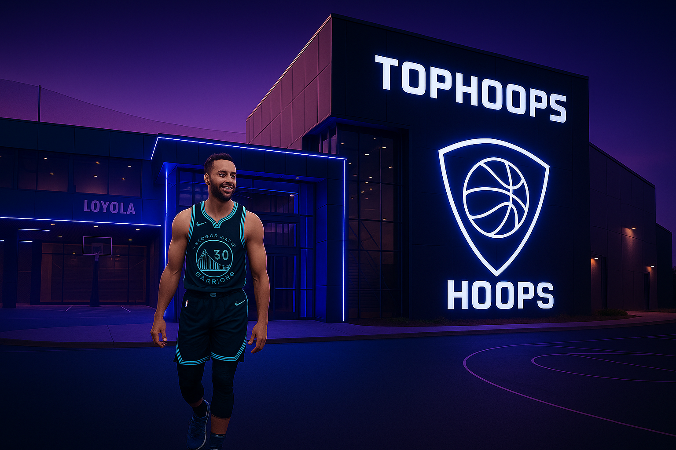
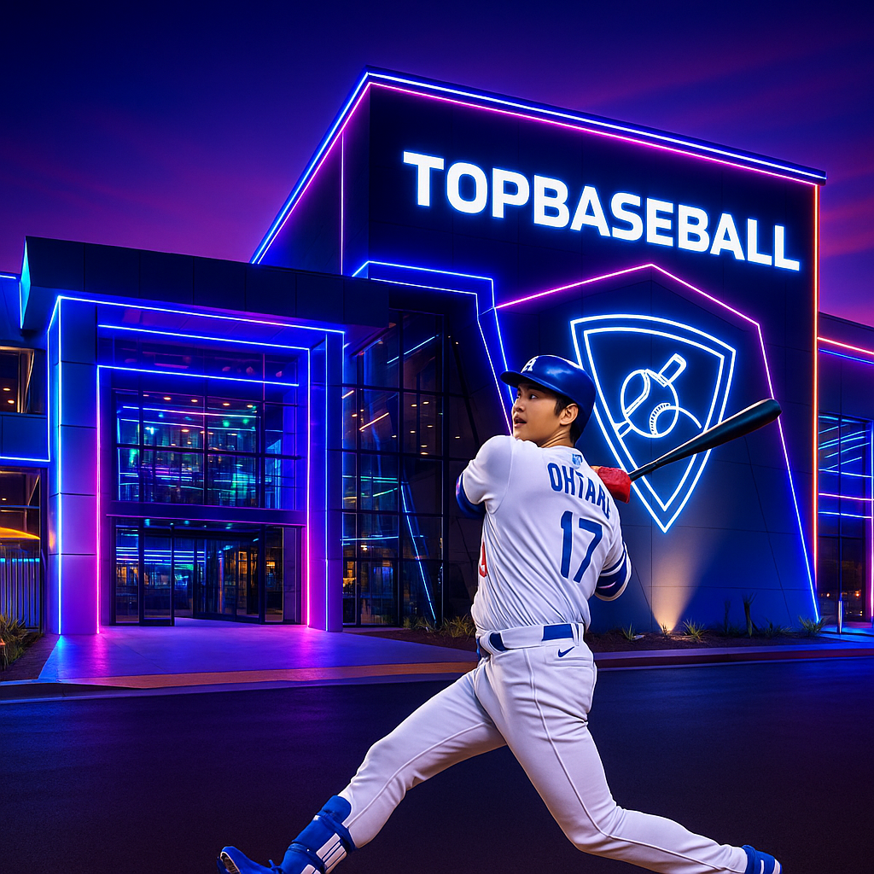
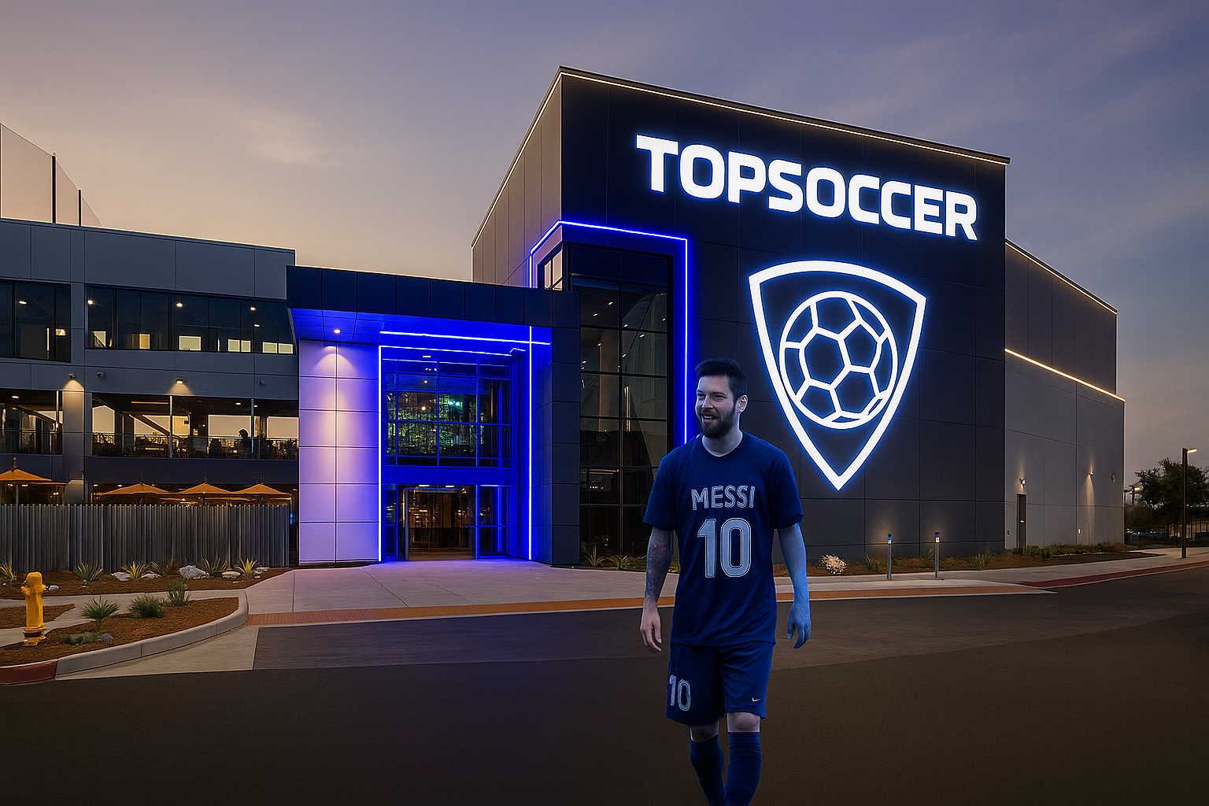
Phase 2: Launch Commercial
Then they all meet up in front of a technologically advanced building.(20sec.)

Slide 22

Phase 2: Launch Commercial
Finally, our logos appear on the screen with a slogan to entice attendance.(30sec.)
“Topgolf. Now beyond the tee. Find your game.”

Slide 23
Phase 3: Post-Launch
Athlete Sponsorship
Social Media
Brand Partnerships
Release highlight reels of athlete tournaments and public challenges.
Launch athlete-hosted competitions (e.g., 3-point contests, penalty shootouts).
Athletes rep their respective sports’ brand.
Shift to “community building” content: customer spotlights, league announcements, birthday parties/events.
Launch loyalty program promotions across platforms.
Continue influencer presence.
Ongoing brand nights (e.g., “Adidas Soccer Saturdays” or “Nike Basketball Thursdays”).
Collaborate on mini-leagues or youth camps with sports brand sponsors.
Collaborate with local small businesses for promotions and exposure.
Goal: Maintain momentum, deepen engagement, and measure success.

Slide 24
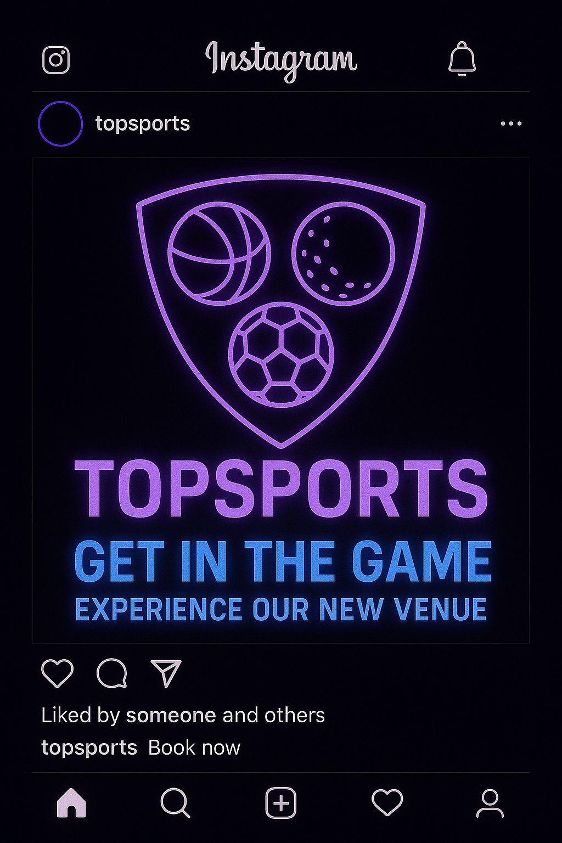
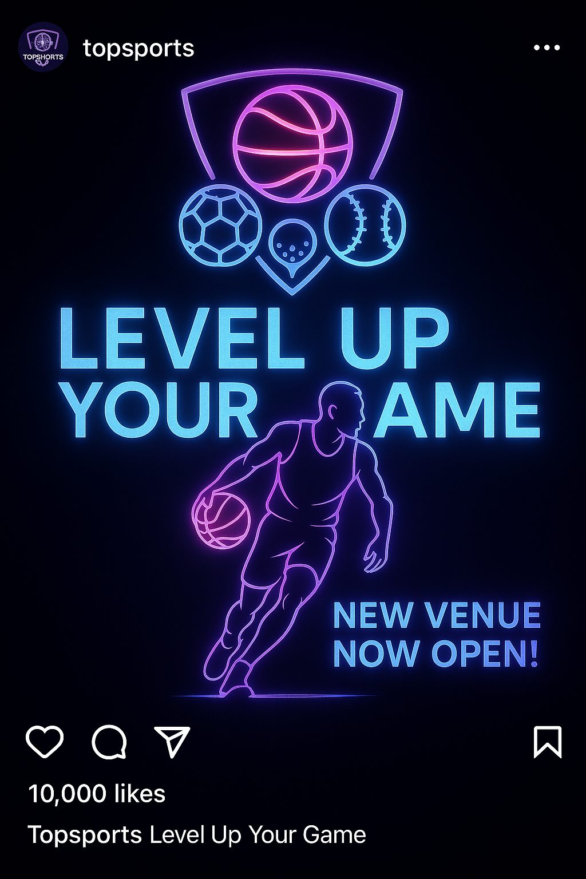
Phase 3: Post-Launch
Targeted Instagram posts for the new Topsports flagship location in Los Angeles, CA.
Social media platforms will now be with the name Topsports, and we will promote this location heavily.

Slide 25
6 Month Plan
 | JULY | AUGUST | SEPTEMBER | OCTOBER | NOVEMBER | DECEMBER
Athlete Sponsorship | Announce Partnership with Curry, Ohtani, and Messi. | Run our commercial with the three athletes. | Focus on Messi with Topsoccer events where he attends. | Focus on Ohtani and Topbaseball with World Series. | Topsports campaign with all three athletes. | Holiday inspired ads and events at our multi-sport LA location.
Digital/ Social Media | Venue Countdown Teasers + Sneak Peeks | #TophoopsChallenges and heavy coverage on social media. | Teasers about new flagship location and early sneak peeks. | Content about how Topbaseball is the best for watching the World Series. | Instagram posts and media presence shift. | Holiday themed content with influencer partnerships.
Brand Partnerships | Initial Partnership with Nike, Gatorade, and Easton. | Outside brands’ merchandise placed into gift shops. | Nike-hosted event at Topsoccer, merchandise give-aways. | Homerun Derby with MLB, competitions. | Partnership with Decathlon for a multi-sport competition. | Coca-Cola collab with their holiday cans.
Budget | $1,000,000 | $250,000 | $250,000 | $250,000 | $750,000 | $1,000,000

Slide 26
6
Performance Metrics

Slide 27
Key performance metrics
Engagement
Revenue
Marketing
Quantifying the customer engagement and experience, and we will measure our customers’ foot traffic, or how many people visit each location per week, along with the repeat visit rate of people who visit Topgolf.
Primarily using data such as how much each person spends at the sports location per visit and the total revenue that each sport makes comparative to the other sport variations.
We will measure marketing effectiveness by analyzing which advertisements generate the most customer engagement and drive physical visits to our new standalone sports locations.

Slide 28
(The Bottom Line)
Our Problem
Our Action
Topgolf’s revenue is faltering, and they are limited to just one sport, missing new audience opportunities.
Launch targeted marketing to drive awareness and traffic through digital ads, social media, and local events
Our proposal
Create standalone venues for basketball, soccer, and baseball experiences.
Our Vision
Build the future of sports entertainment—one game at a time.
Our Goal
Expand the Topgolf brand into a multi-sport, social experience.

Slide 29
Thank
You

